Slide 1
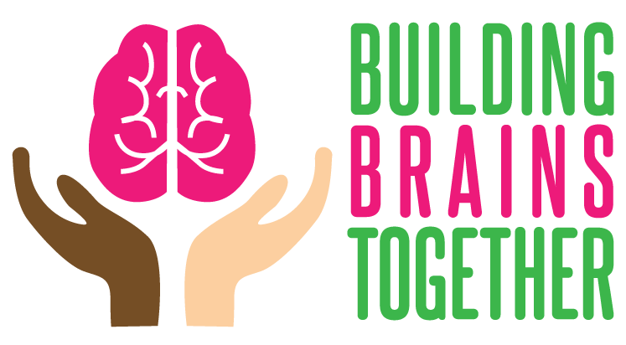
Strengthening the Aging Brain
www.buildingbrains.ca
Robbin Gibb, PhD
Canadian Centre for Behavioural Neuroscience
University of Lethbridge
Notes:
Today we are going to discuss stress and healthy aging.

Slide 2
How we derive our genome

Slide 3
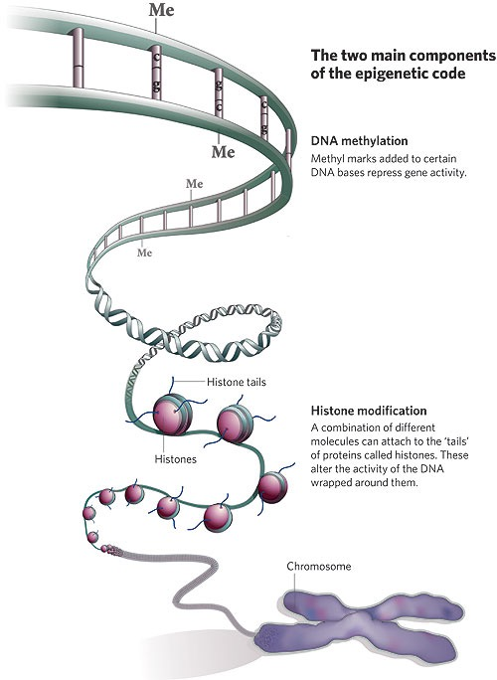
Each gene contains a unique set of instructions that is carried out if endorsed (signed) by
the environment. This is what is known as the “signature effect”
Notes:
The programming of the genome is controlled by the epigenome
The epigenome is composed of two components:
1) the chromatin which is associated with the DNA and
2) DNA methylation which is part of the covalent structure of the genome and is therefore a stable long-term signal
It was long believed that DNA methylation is fixed and irreversible

Slide 4
Epigenetic Changes Cause Brain Changes: Brain Plasticity
Brain plasticity offers an adaptive advantage. We can “learn” from our experiences and that should allow us to engage more appropriate behavioural responses in future situations
Brain changes Behavioural changes
Experience (Environment)
But - Not all brain plasticity is positive! (Think of bad habits)
Notes:
What is experience?
Everything that you encounter both pre- and postnatally, as well as in adulthood
Examples are light, touch, sound, food, thoughts, injury, drugs, disease

Slide 5
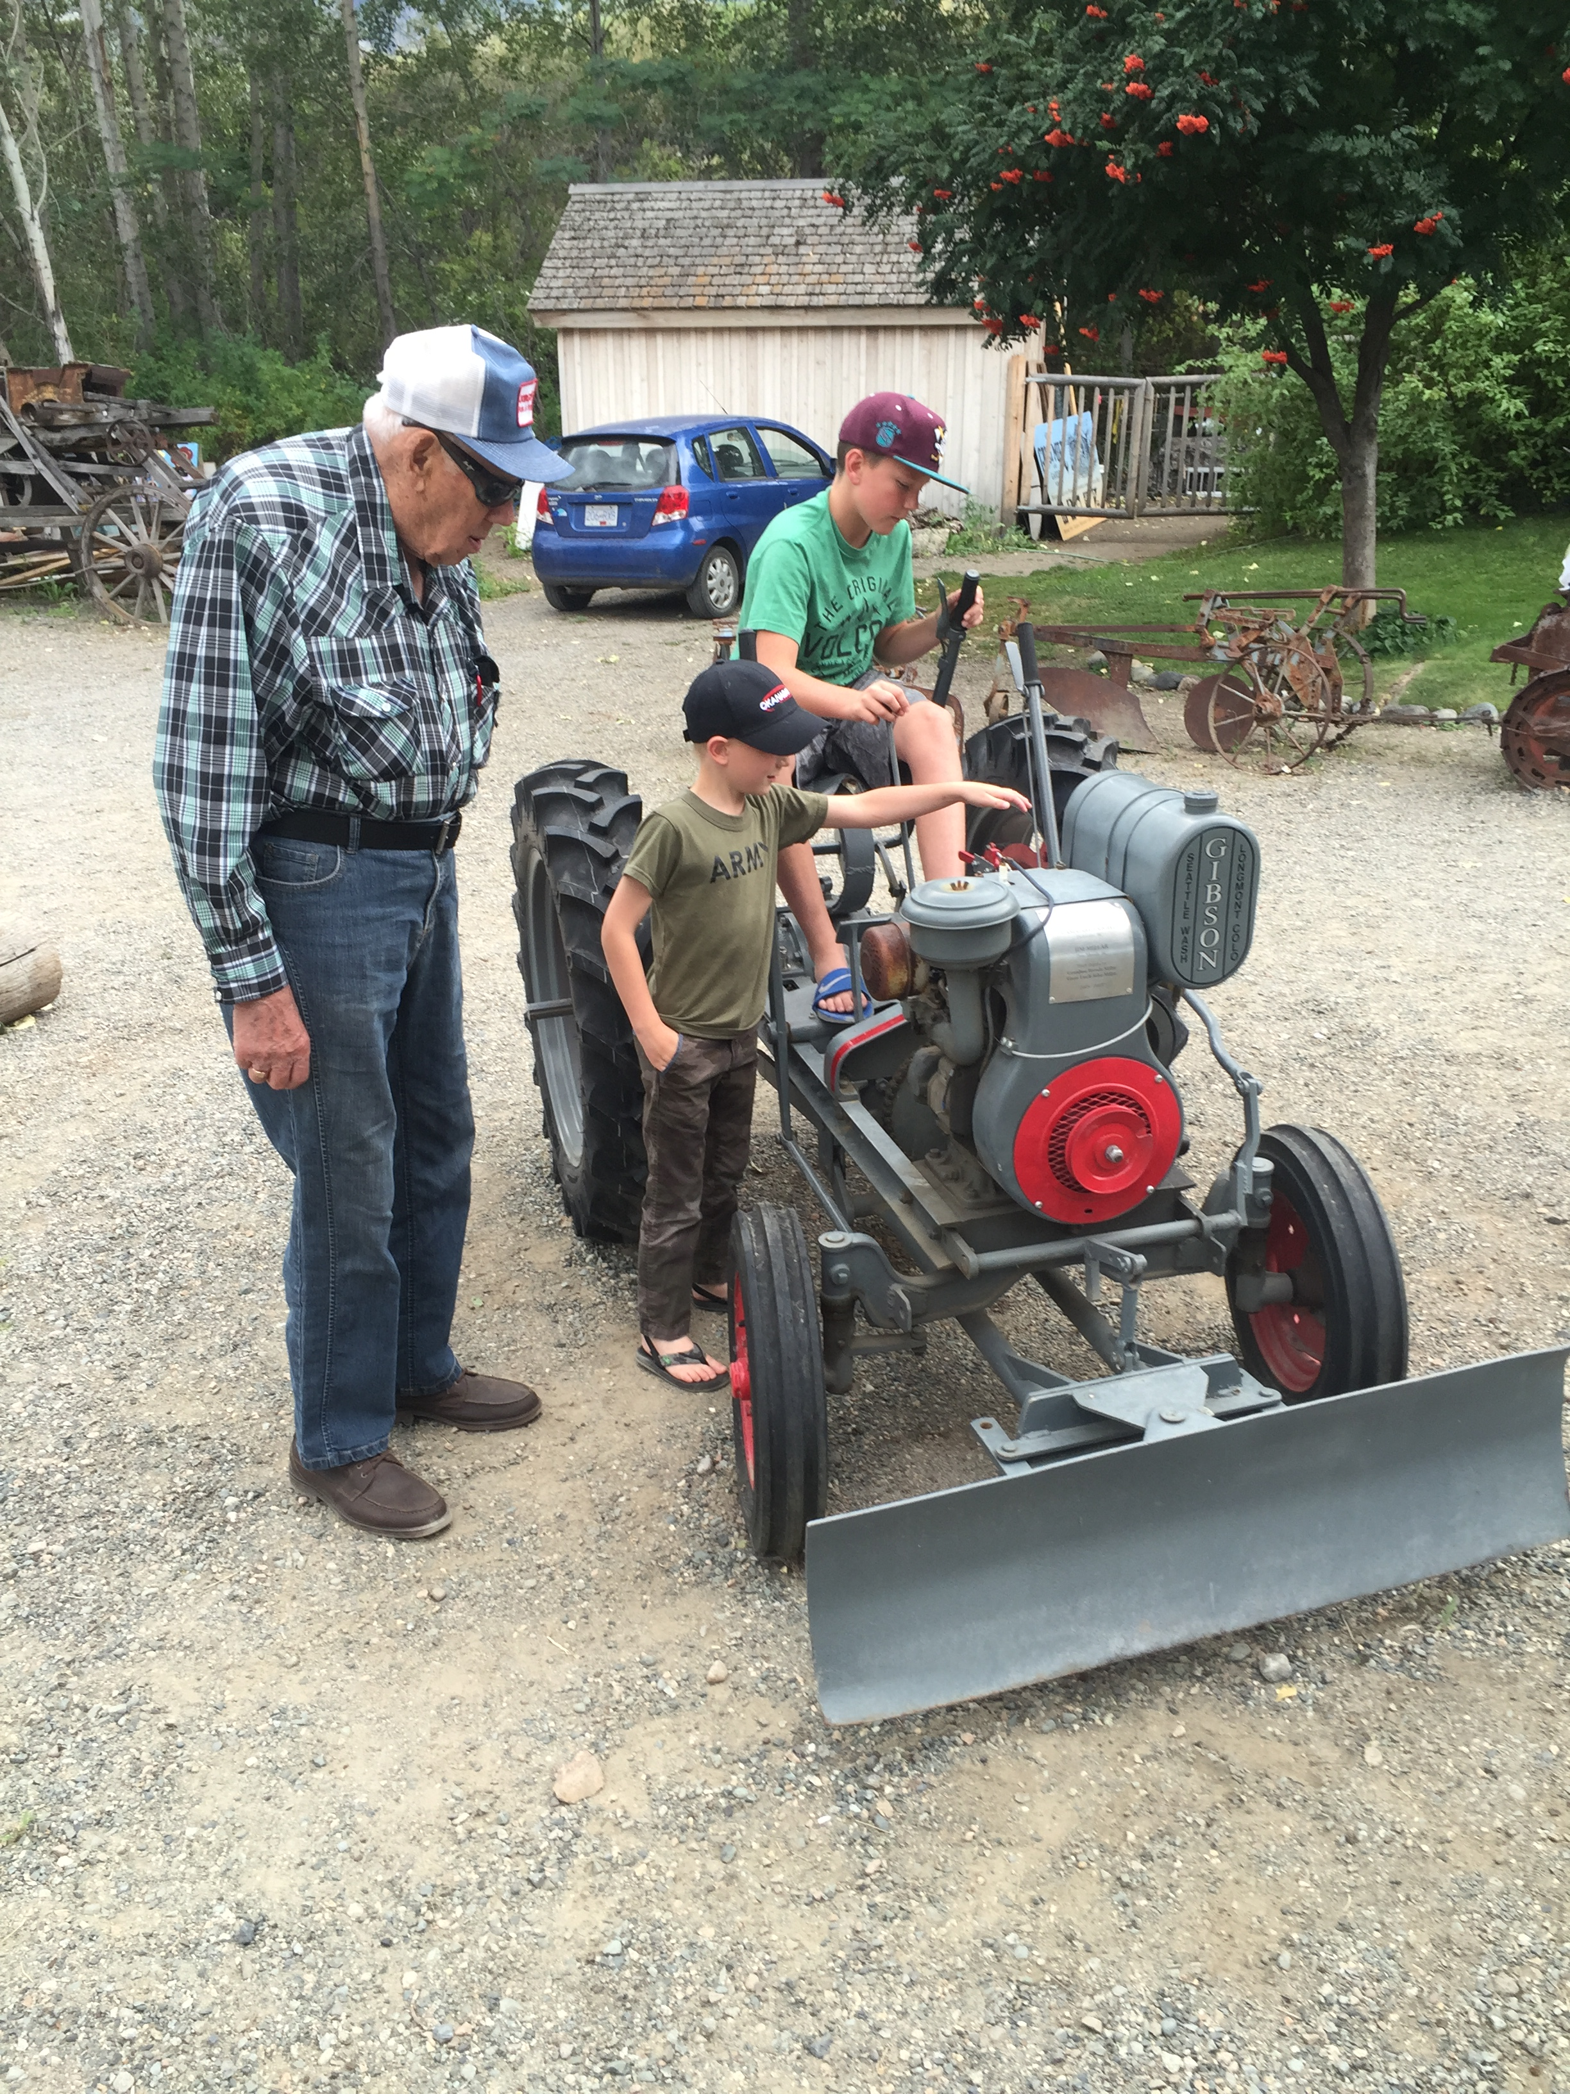
BIGGEST FEAR AMONGST SENIORS
Losing cognitive abilities
Loss of independence & altered self- perception
90 yr. olds 75% more likely to show signs of cognitive decline than those in their 70s.
Cognitive decline is NOT a direct effect of aging

Slide 6
WELLNESS
Both a Holistic and Multidimensional state that can be achieved and leads to optimizing an individual’s potential
Strout et al. 2016

Slide 7
SIX DIMENSIONS OF WELLNESS
Social
Intellectual
Emotional
Spiritual
Occupational
Physical

Slide 8
SOCIAL
Relationships- ability to maintain and nurture both personal and community relationships
Social situations promote healthy stress that helps to optimize brain function

Slide 9
SOCIAL
Have lots of close friends in community
Count on friends for
Support
Companionship
Involved in Community
Actively pursue involvement in daily life*
Not Lonely * (Self-Report)

Slide 10
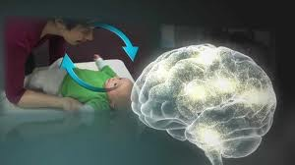
NUMBER 1 NEED?
NEED FOR ONGOING, NURTURING RELATIONSHIPS

Slide 11
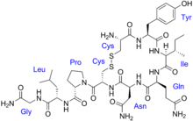
The BONDING HORMONE (aka the love hormone)
Resiliency is promoted by
the release of Oxytocin
Oxytocin
buffers stress & is present in higher levels in the company of an ”attached” or nurturing adult
is involved in brain plasticity & this allows individuals to overcome adversity through relationships
Humans are social beings and thrive on relationships
=

Slide 12
INTELLECTUAL
Lifelong learning.
Actively pursuing new knowledge and or skills and sharing it and the joys that come with learning it.

Slide 13
SEDENTARY BEHAVIOUR
Activities that are characterized by sitting.
Adults spend ~70% of their time doing this
Older adults- even more
Associated with less successful aging: physically, psychologically, and socially

Slide 14
SEDENTARY BEHAVIOUR
BUT, no-one has ever characterized the nature of sedentary behavior and not all sedentary behavior is equal
Two beneficial activities that are associated with sitting- cognitive stimulation ie computer use and reading
Socializing ie BINGO and visiting

Slide 15
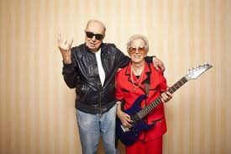
INTELLECTUAL
Crossword puzzles (Must be challenging)
Crafts or Arts
Educational Courses (U of L is free after 65)
Computer activities *
Reading*
500 × 334 - bruderheim.ca

Slide 16
EXECUTIVE FUNCTIONS (EF)
A set a skills that help us define and achieve goals.
Three main categories are working memory, cognitive flexibility, and behavioural inhibition.
Problem solving, attention, monitoring, planning and organizing materials, self-regulation, emotional control etc. contribute to the executive system.
Better EF skills are reflected by lifelong success
Connected to emotional centre to aid in interpreting situations

Slide 17
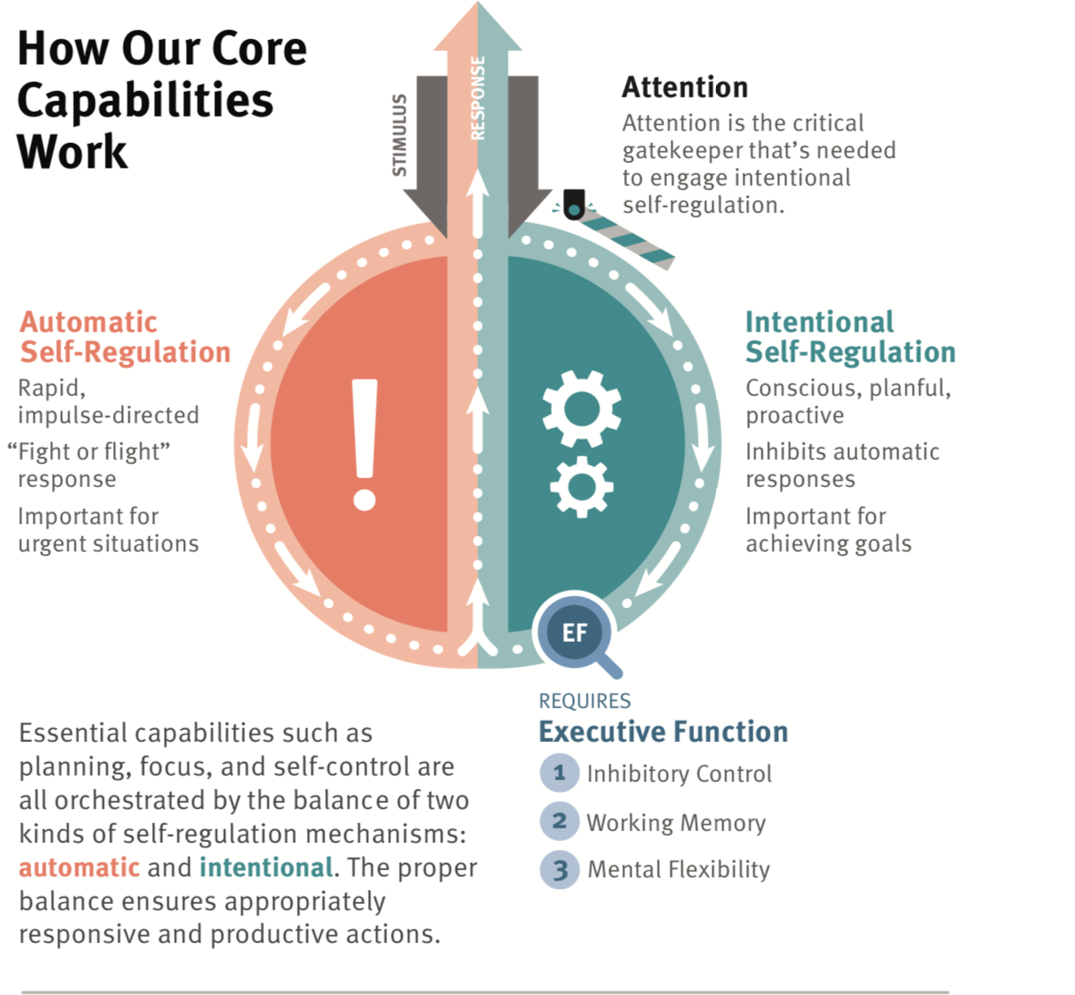
Notes:
Source: https://www.gse.harvard.edu/sites/default/files//media/330x350-uk-cdc-core-capabilities.jpg

Slide 18
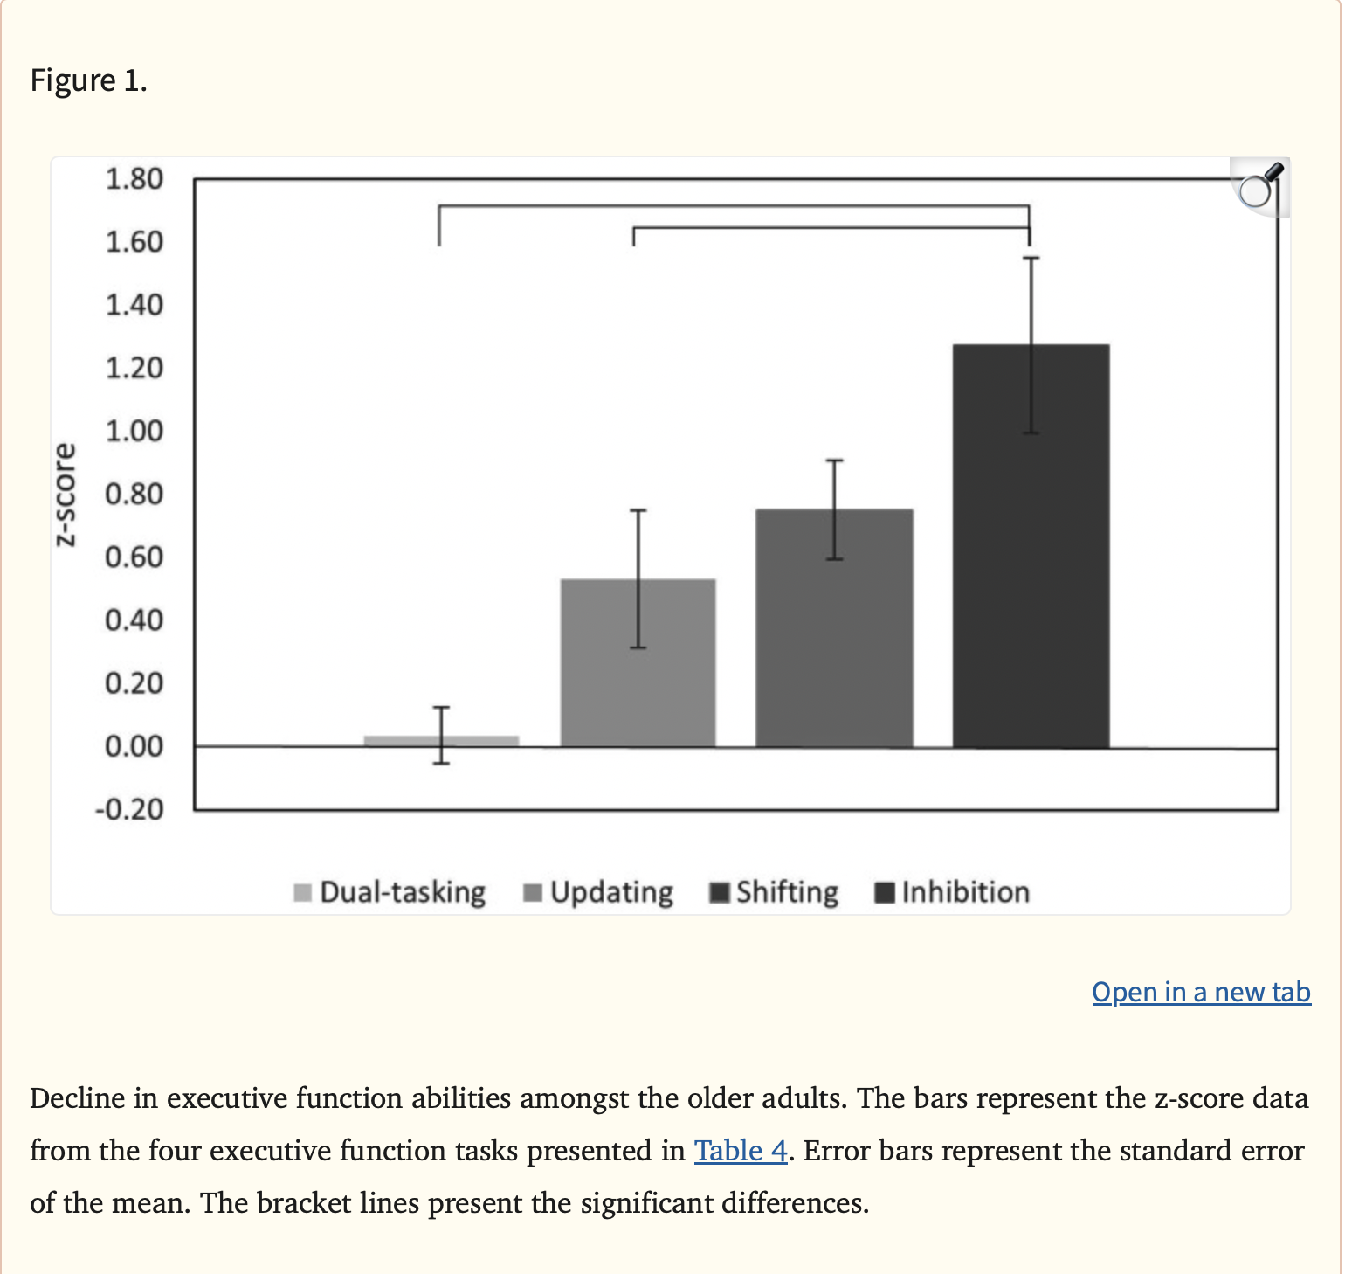

Slide 19
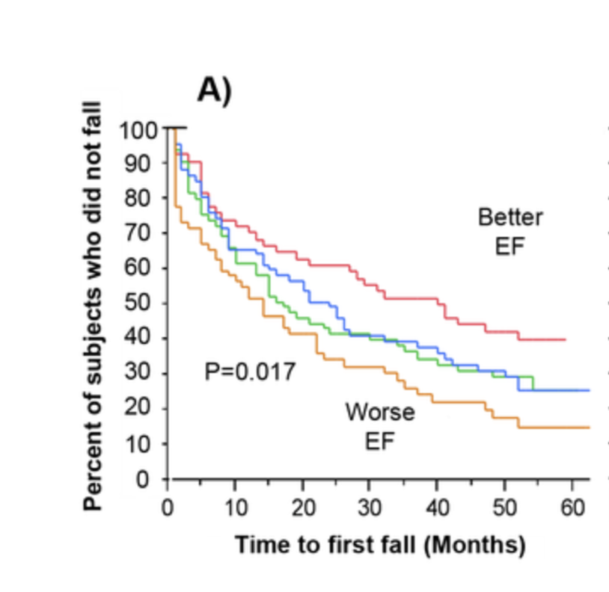

Slide 20
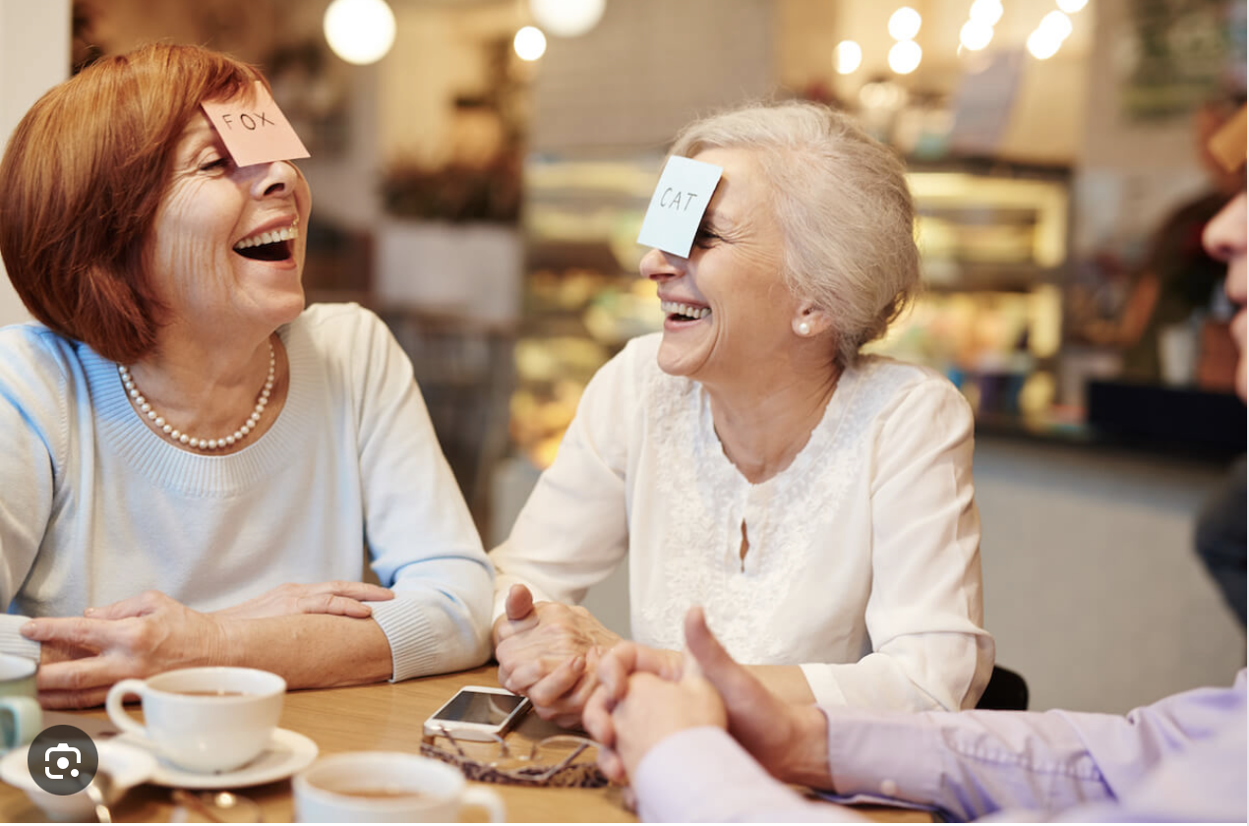
WAYS TO IMPROVE EF?
Language Learning & Music
Exercise, Sports
Nutrition
High Quality and Enough Sleep
Mindfulness Practices (Yoga, Martial Arts)
Protection from TOXIC stress
PLAY with BBT (buildingbrains.ca)

Slide 21
Bilinguals
Verbal skills (semantic fluency,vocabulary size, and picture naming) of bilinguals are generally weaker in each language compared to monolinguals
HOWEVER
Bilingualism is associated with higher cognitive reserve- as one ages, there is more brain capacity to deal with stroke, or injury if one is bilingual

Slide 22
Playing an instrument
Ensemble activity. It involves:
Attention
Thinking Ahead
Remembering
Coordinating Movement
Monitoring feedback (ears, fingers, and/or lips)
Engages most of your brain

Slide 23
Benefits of Singing
Aerobic exercise- improves cardiovascular health
Increases blood oxygenation
Reduces stress
Improves general health across the lifespan
Activates multiple brain areas (pitch, rhythm, timbre, language)
Singing with others activates areas involved in social processing (OFC)
Strong indicator of good pronunciation in a foreign language (better imitator of speech)

Slide 24
EMOTIONAL
Takes personal responsibility for life decisions and outcomes
Emotional stability. Able to regulate emotions and maintain an overall positive outlook

Slide 25
EMOTIONAL
Not anxious or sad
Feels valued
Interest and/or pleasure in usual activities *
Delighted or pleased with life*

Slide 26
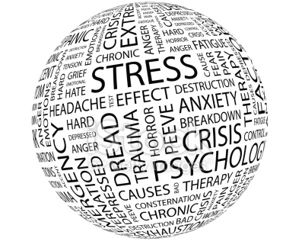
What is stress?
the body’s reaction to a change that requires a physical, mental, or emotional adjustment or response
stress can be caused by both good and bad experiences

Slide 27
Types of stress
EUSTRESS
positive stress caused by good experiences
increases our performance (both physical & mental)
DISTRESS
(toxic stress)
negative stressed caused by bad experiences
decreases our performance (both physical & mental)

Slide 28
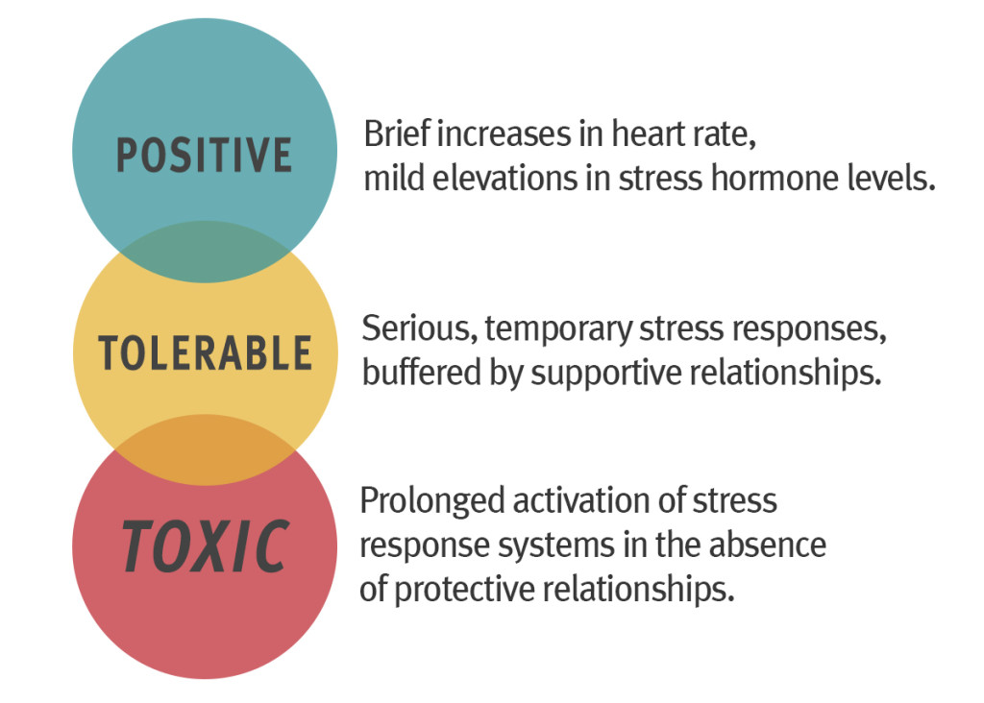
Types of stress
Notes:
Source: developingchild.harvard.edu

Slide 29
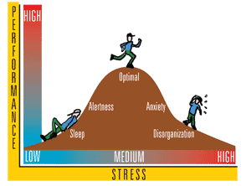
Stress Performance Connection

Slide 30
Early Experience alters stress axis
positive or tolerable
STRESS
toxic STRESS
STRESS REACTIVITY
MODEST STRESS REACTIVITY
= reduced risk for disease
INCREASED STRESS REACTIVITY
= increased risk for heart disease, type 2 diabetes, alcoholism, affective disorders, brain aging etc

Slide 31
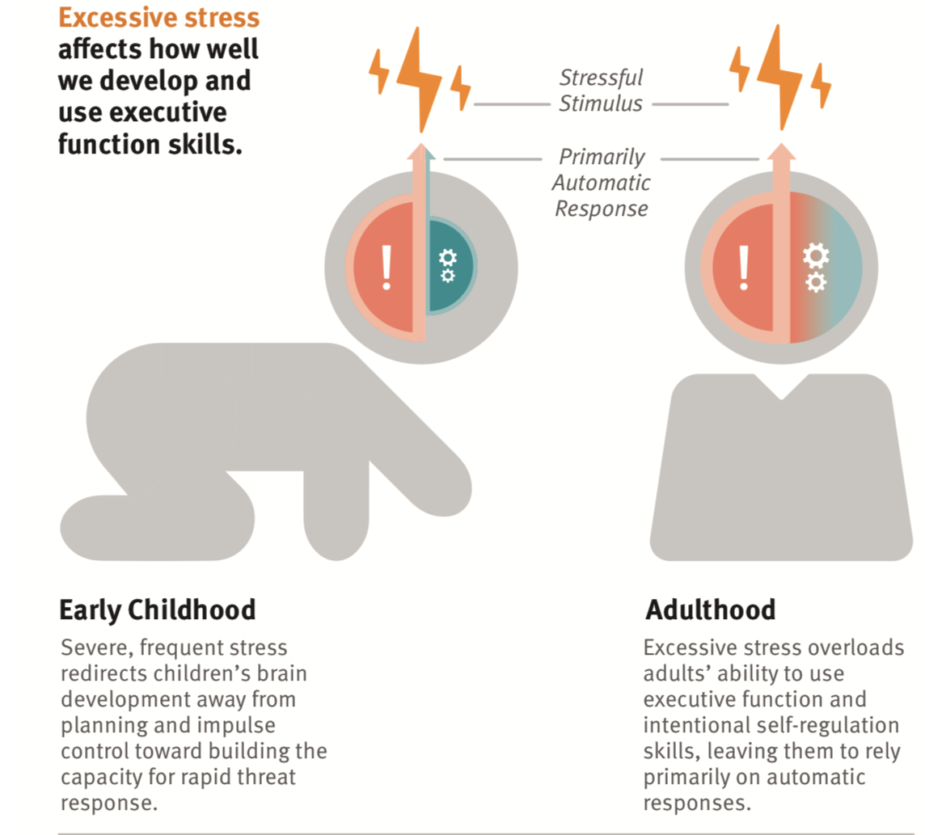
Notes:
Source: https://image.slidesharecdn.com/aragon-tomaspopulation-health-101beaver-170421032440/95/what-is-population-health-16-638.jpg?cb=1494391739

Slide 32
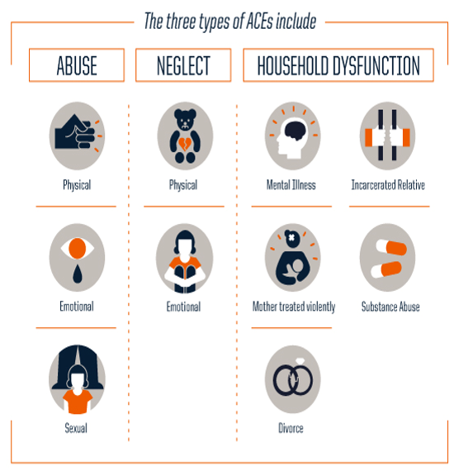
What are Adverse Childhood Experiences (ACES)?
https://docsfortots.org/aces/
Notes:
https://docsfortots.org/aces/

Slide 33
Outcomes after age 55
Health in midlife is related to ACEs
-smoking or other addictions
-heart and lung disease
-depression
-diabetes
-hypertension
-macular degeneration
-psoriasis
-suicide (or attempted)
The increase in incidence varies from about 3X for smoking to 50X for drug addiction, and 50X for attempted suicide with more than 2 ACE’s

Slide 34
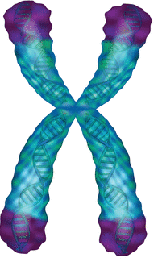
Telomeres naturally shorten as we age and with each cell replication
Telomeres
are protective caps
on the ends of our chromosomes
Toxic stress accelerates the shortening process
The length of the telomeres determines how many times a cell can divide
Building healthy nurturing relationships can reverse telomere degradation
Listen to Dr. Elizabeth Blackburn’s Ted Talk on the puzzle of aging

Slide 35
SPIRITUAL
Having purpose in life
Value system
Finding meaning in day-to-day life
Engaged in mindfulness activities or meditation
Spiritual needs are met*

Slide 36
OCCUPATIONAL
Ability to contribute skills to meaningful work
Paid
unpaid
No strong correlations on tested domains with cognitive improvement
Generally, people like to feel they add value to society
NOT MANY STUDIES DONE TO DATE WITH WELL DEFINED FACTORS AND ASSESSMENTS

Slide 37
PHYSICAL WELLNESS
Interested in self-care and maintaining good health
Control blood pressure
Sensory supports (Glasses update, Hearing aids if needed)

Slide 38
PHYSICAL Committed to regular participation in physical activity, healthy eating habits, sleep
Resistance training *
Biking, pilates, yoga, Tai-chi, swimming, walking**
3 or more hours of exercise in last 3 days**
Going outside at least 3 times in last three days*

Slide 39
Physical Activity
Aerobic training- BDNF
Resistance Training- ILGF Reduced risk of Falls and limb fractures
Training intervals varied but modest regular exercise- brisk walking 30min 5 X per week resulted in improved memory and cognition scores - good retention of improvements

Slide 40
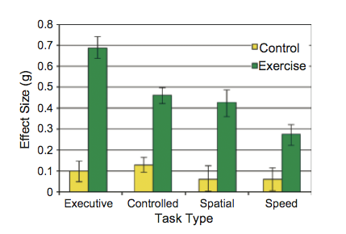
Effect of Physical Exercise on Mental Tasks

Slide 41
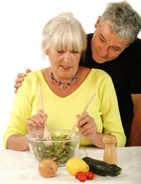
Diet
Older people often lose appetite or become less interested in preparing wholesome food
Less folic acid and Vit B-12 associated with cognitive decline
Omega 3 and 6 help maintain health myelin- therefore healthy connections
Antioxidants (Vit C ,E) reduce oxidative stress

Slide 42
Diet
choline in diet - translates into enhanced production of Acetylcholine
loss of ACh implicated in AD
Intermittent Fasting (8 hour window for eating) associated with cognitive and metabolic benefits
Loss of appetite often related to loss of sense of smell

Slide 43
Diet
Food doesn't taste as good if you can't smell it
Loss of sense of smell predicts cognitive decline
can precede onset of Parkinson's or AD by 10 years or more
Lowered ability to identify odors is associated with lower cognitive function at the time of testing

Slide 44
Sleep
Most people don't get enough
Significant link to how well someone sleeps and their overall health and function
Sleep deprived people have poor regulation of hormones - appetite and hunger
Sleep is when the brain does its self-clean

Slide 45
Sleep and Memory - Stickgold, Harvard
Adequate sleep before you attempt to learn something new
Better attention
Better motivation
Better grasp of the new concept or task
Adequate sleep following learning
Consolidates the learning
Strengthens connections in the brain
Only effective immediately after learning (1st night)

Slide 46
Sleep dysregulation
Disrupted sleep cycles more common as we age
Significant disruption associated with increased risk of schizophrenia, AD and other mental disorders
Removal of metabolic waste by products doesn’t happen in fragmented sleep

Slide 47
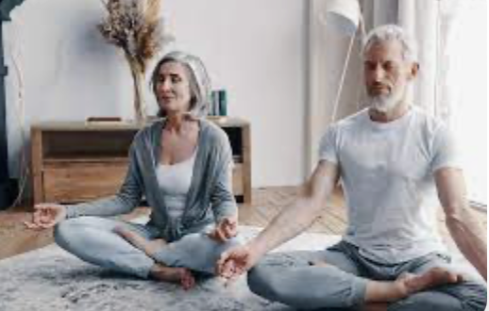
Wellness Promoting Activities and Brain Health
Mindfulness practices (Meditation, yoga)
Changes cortical thickness, grey matter density, neuroplasticity, EEG
Reduce stress
Promote sense of well-being
Improves learning and memory, emotional regulation (self –reg), perspective taking

Slide 48
THE BENEFITS OF A SMILE
DR. RON GUTMAN HAS SHOWN THAT SMILING RESULTS IN :
BLOOD PRESSURE
ENDORPHINS
STRESS HORMONES (CORTISOL, ADRENALINE, DOPAMINE)

Slide 49
Humor Associated Mirthful Laughter (HAML) Birk et al., 2014
Meditation used to promote wellness
Gamma wave spectrum (31-40 Hz) in EEG increases with mindfulness practices such as meditation. This is what devotees of these practices strive for.
HAML has a powerful effect in producing gamma waves
Maybe an underutilized means of promoting wellness

Slide 50
BEST RESULTS FOR WELLNESS APPROACH
Start early –
Healthy lifestyle changes early in life have big payoffs for cognitive health later
BUT even older adults can benefit from adhering to healthy lifestyle choices
Wellness interventions in this population can have a positive impact

Slide 51
Zone of Possible Cognitive Performance in Adulthood
Notes:
Where you fall in the zone is influenced by biological, behavioural and environmental influences.

Slide 52
Possible Cognitive Performance of an Individual
Notes:
Curve A-optimization of function causes the individual to approach maximal levels of cognition
Curve B- relatively good lifestyle habits and typical engagement in work and leisure activities in young adulthood to middle age-BUT rapid rate of decline after 50. May reflect inertial tendencies of individual not to adapt or compensate for changing mechanistic basis of cognition
Curve C-Shows that late life improvements in cognitive functioning is possible if an individual engages in enriching activities of a quality and degree not typical of early adulthood. Outcome not as good as A but not as bad as B.
Curve D - maladaptive behaviours cause a precipitous loss of cognitive ability early in adult life

Slide 53
BIGGEST PROBLEM WITH PHYSICAL AND INTELLECTUAL ACTIVITES THAT PROMOTE IMPROVED BRAIN FUNCTION?
What works for one may not be of benefit for another
Using a multifaceted approach may be the answer
A range of effective behavioral interventions a must to provide sound advice to a range of individuals

Slide 54
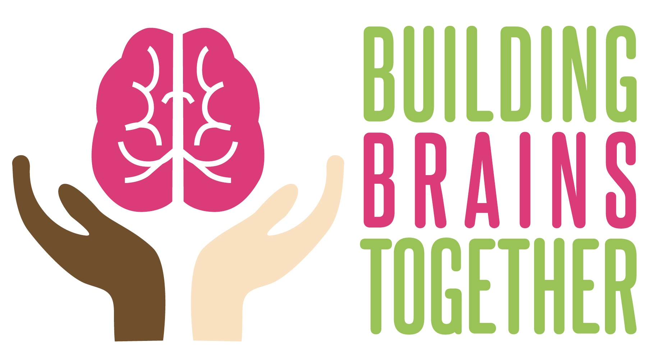
Building Brains Together
Supporting Executive Function in SENIORS Through Play
Buildingbrain.ca

Slide 55
Play Reduces Stress
Engaging in play
Reduces CORTISOL
Increases anandamide
Increases endorphins
Increases sense of pleasure
Increases joy and laughter

Slide 56
Play Improves Relationships
Fosters caring and compassionate responses
Develops empathy
Promotes trust
*Nuturing relationships build brain

Slide 57
Play Improves Executive Function
Engaging in play
Promotes self-regulation or the ability to manage your emotions
Increases connection in the frontal lobe –an area that supports Executive Functions

Slide 58
Dr. Stuart Brown- Founder of National Institute of Play (CA)

Slide 59
PREVENTING COGNITIVE DECLINE USING A MULTIFACTED APPROACH
Positive changes seen all over brain (Temporal lobe- memory; Thalamus- sensorimotor processing; PFC: executive function)
Enhanced blood flow

Slide 60
RECAP OF PROTECTIVE INTERVENTIONS AGAINST COGNITIVE DECLINE
Physical Activity:Swimming, biking, hiking, walking-being outside
Computer Activities
Reading
Feeling delighted with life
Pursuing involvement in everyday life
Not lonely

Slide 61
RECAP OF PROTECTIVE INTERVENTIONS AGAINST COGNITIVE DECLINE
Get enough sleep
Eat well (Multivitamin supplement, Omega 3’s, Tumeric or Curcumin)
Mindfulness activities, YOGA
Laugh and smile
Enjoy making music: instrumental, singing
Play

Slide 62
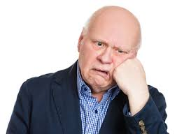
DIFFERENT STROKES FOR DIFFERENT FOLKS
Important to recognize the enjoyment that a participants feels while engaged in an intervention
Not everyone will LOVE the same activities
TRY TO BE INVOLVED IN MORE THAN ONE!

Slide 63
MAXIMUM EFFECT?
Enjoyable and engaging experiences

Slide 64
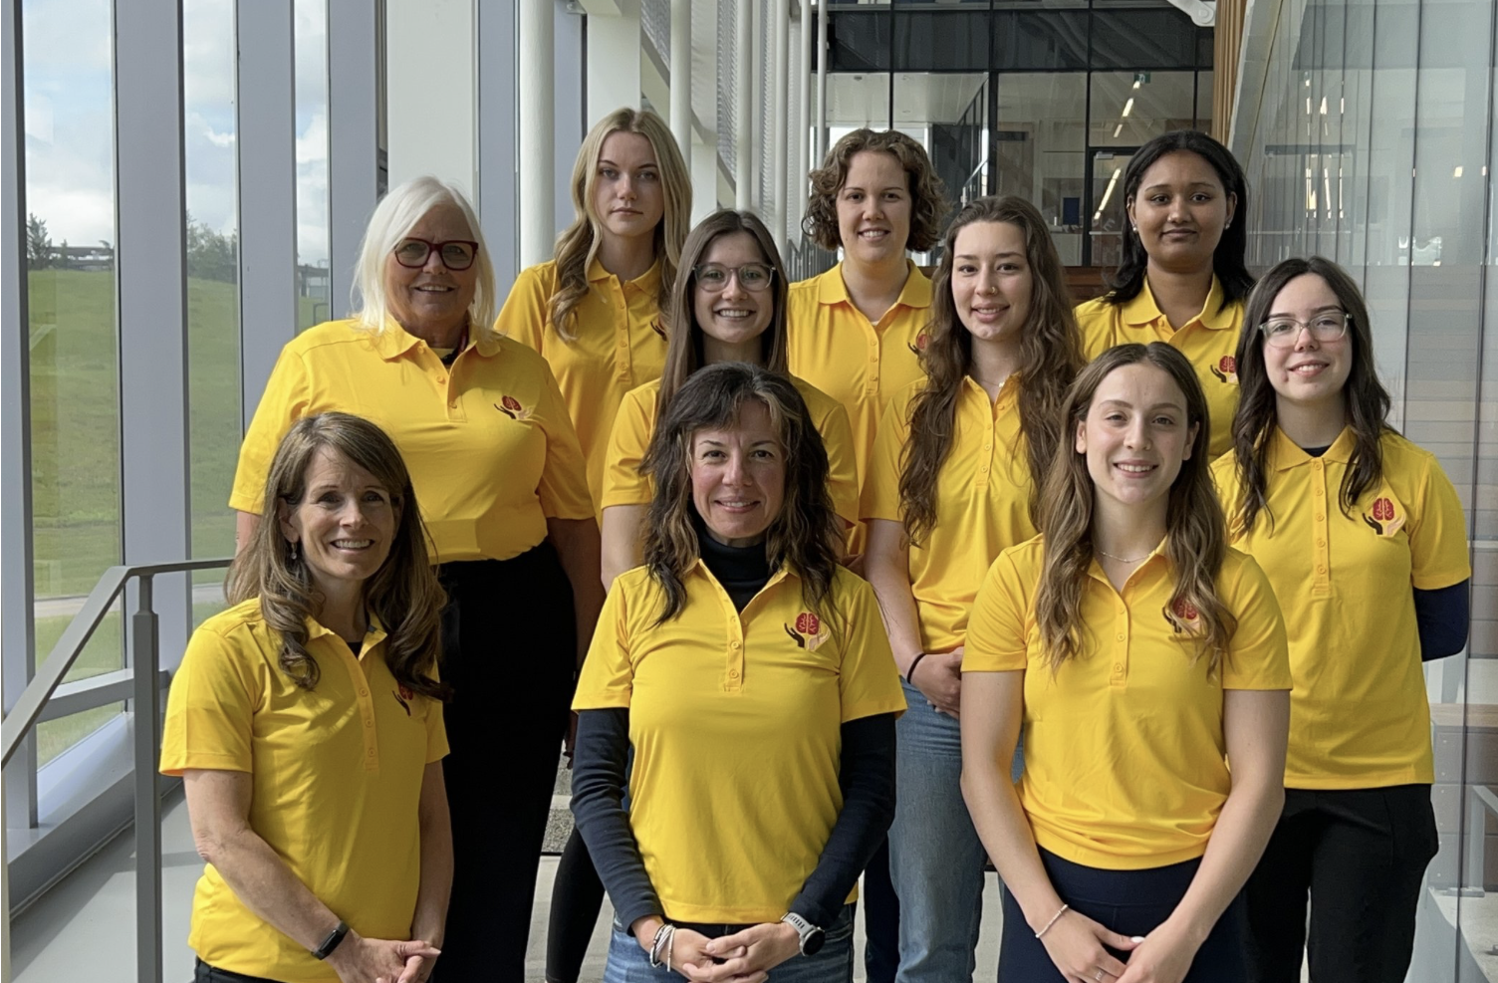
Contributors to the BBT Work (PLAY)

Slide 65
