Slide 1

Urology 101:
Understanding Urologic Health As We Age

Slide 2

Objectives
Introduction
What happens to our Bladder, Prostate, and Sexual Function
Recurrent UTIs
Benign Prostatic Hyperplasia
Incontinence
Sexual Dysfunction
Prostate Cancer
Questions

Slide 3
What happens to our urinary tract as we age?

Slide 4
Age Related Changes - Men
Enlarged prostates – Men
  Urinary Obstruction
  RUTIs
  Urgency and Frequency
  Nocturia
Nocturia
Decreased Testosterone
Prostate Cancer

Slide 5
Age Related Changes - Women
Decreased Estrogen – Women
  Increased Urgency and Frequency
  Incontinence
  RUTIs
  Weak Pelvic Floor
  Prolapse

Slide 6
What Is Asymptomatic Bacteriuria?
>100K bacteria in the urine
No Symptoms = No Treatment Needed
Some people have chronic bacterial colonization
It’s ok to have bacteria in your urine
If you don’t have symptoms, please don’t take antibiotics

Slide 7
Recurrent Urinary Tract Infections (RUTI)

Slide 8
What Is A UTI?
>100K Colony forming units per ml of bacteria per ml
Symptoms:
  Frequency
  Urgency
  Painful Urination

Slide 9
Recurrent UTIs
Definition
  Two Separate Culture Proven Episode within 6 months or 3 episodes in 1 year
Types
  Uncomplicated
    Infection in a health patient with no anatomic or functional abnormality
  Complicated
    Male Gender
    Anatomic or function abnormality of the urinary tract
    Immunocompromised person
    Multi-drug resistant bacteria

Slide 10
RUTI?
60% of women will experience symptomatic UTIs in their lifetime
12% of men will experience a UTI in their lifetime
40% will have another episode
20-50% of these women will have multiple recurrent UTIs
$2.6 billion spent per year in US alone for the evaluation and management of UTIs

Slide 11
Age Related Changes That Lead To UTI
Women
Post menopausal Estrogen loss (25)
Declining immunity and anatomical/physiological defenses (28)
Vaginal Prolapse
Incomplete emptying
Diabetes
Kidney Stones
Men
Enlarging Prostates (24)
Incomplete bladder emptying
Declining immunity and anatomical/physiologic defense
Diabetes (32)
Kidney Stones

Slide 12

How To Prevent UTIs?
Cranberry Supplementation
>35 Proanthocynadins (PACS)
Vaginal Estrogen not oral
D-Mannose
Methenamine
Vaginal Probiotics not oral
Take control of constipation
Vois every 2-3 hours
Drink 2-3 L of water a day

Slide 13
Why Is Vaginal Estrogen So Important?
It changes our vaginal pH to more acidic pH. This in turn invites the “good” bacteria into our vagina which protects us from the Gut bacteria.
Your estrogen levels will not raise above post menopausal levels
There is no risk of stroke, heart attack, blood clots, breast cancer or endometrial cancer, no risk of recurrence either these cancers
It’s safe
It takes 12 weeks to help prevent UTIs!

Slide 14
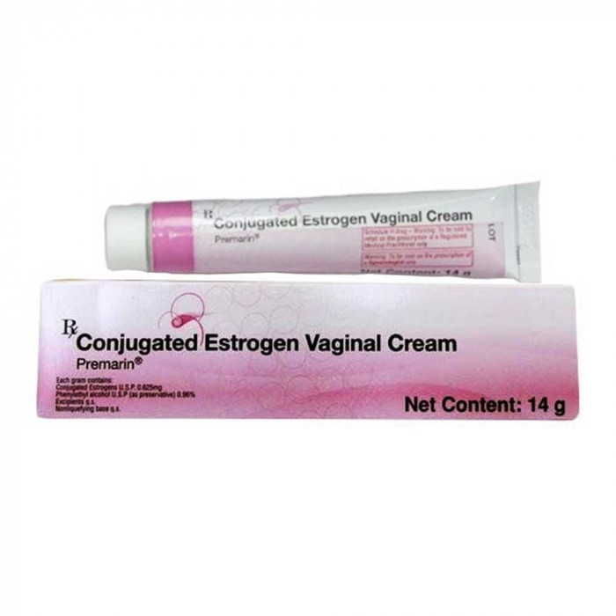
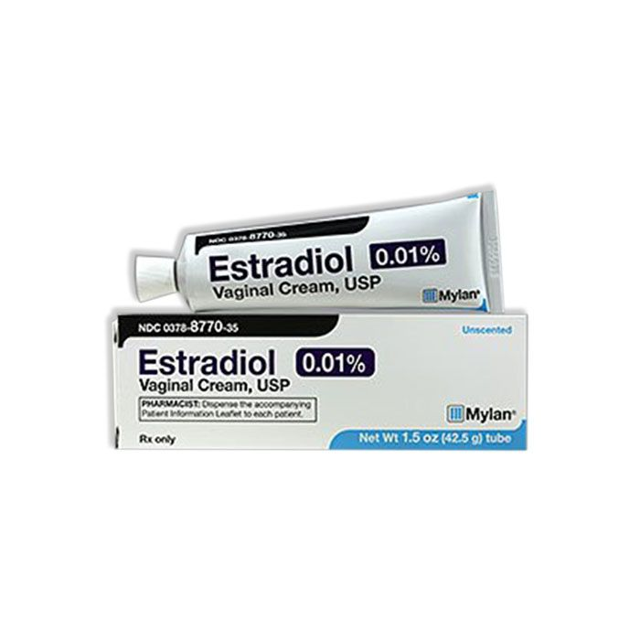
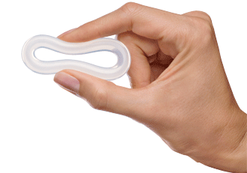
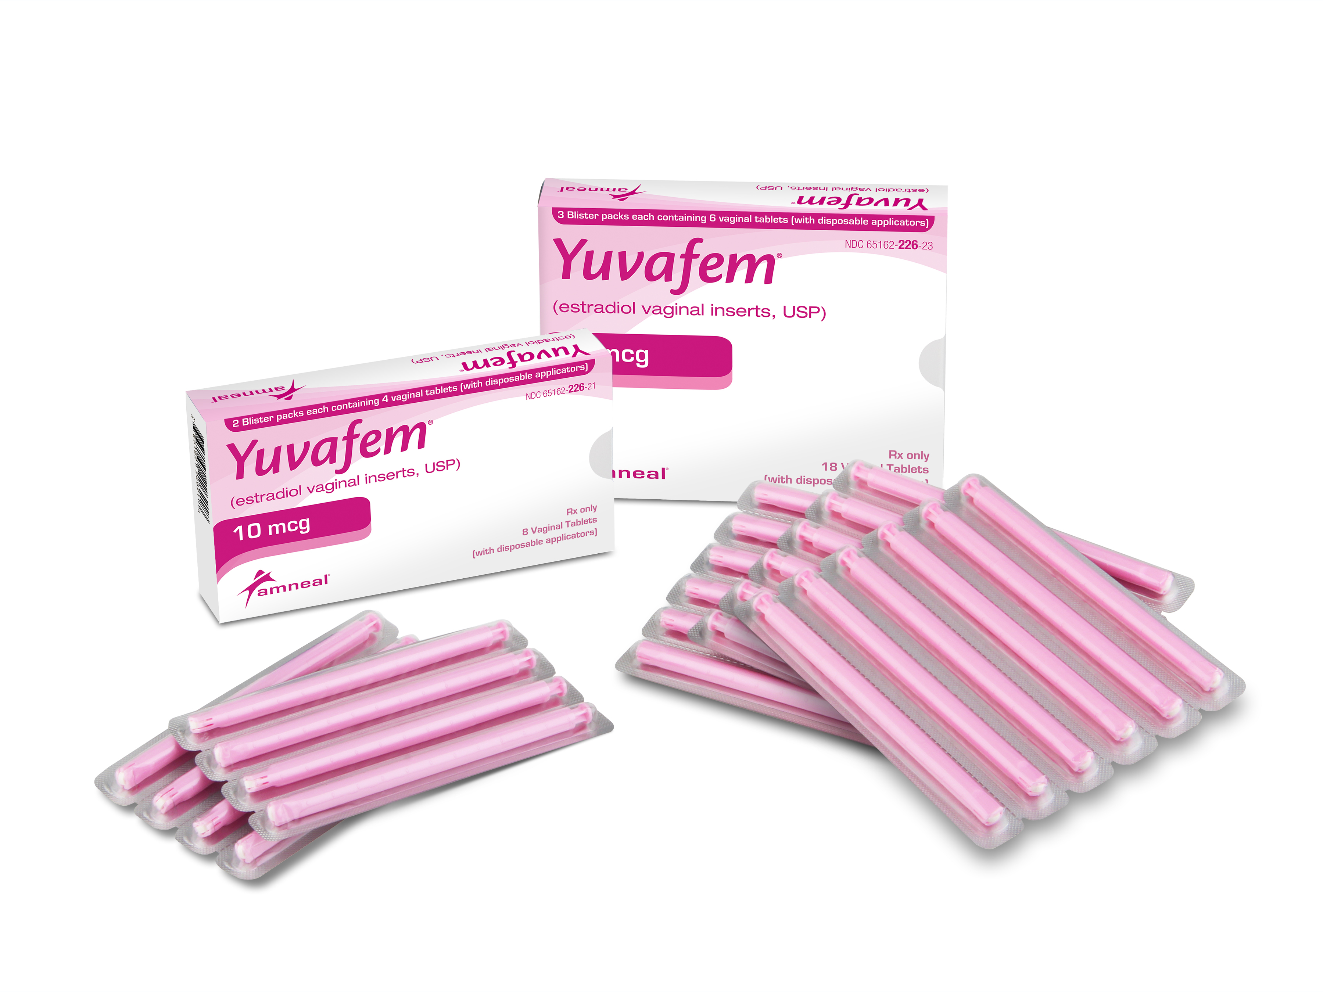
Vaginal Estrogen

Slide 15
The American College of Gynecology and the British Society got Sexual Medicine released a position statement in 2021, which reads, “Women with a history of any type of cancer, including estrogen-receptor-positive cancer, should use vaginal estrogen if required and if beneficial; they should continue using this in the long term.”⁴⁰

Slide 16
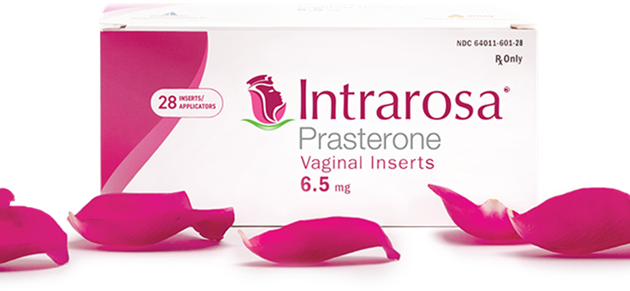
DHEA Vaginal
This is converted to Estrogen and Testosterone
Most Breast Cancer Surgeons will allow you to use this product

Slide 17
Benign Prostatic Hyperplasia
BPH

Slide 18
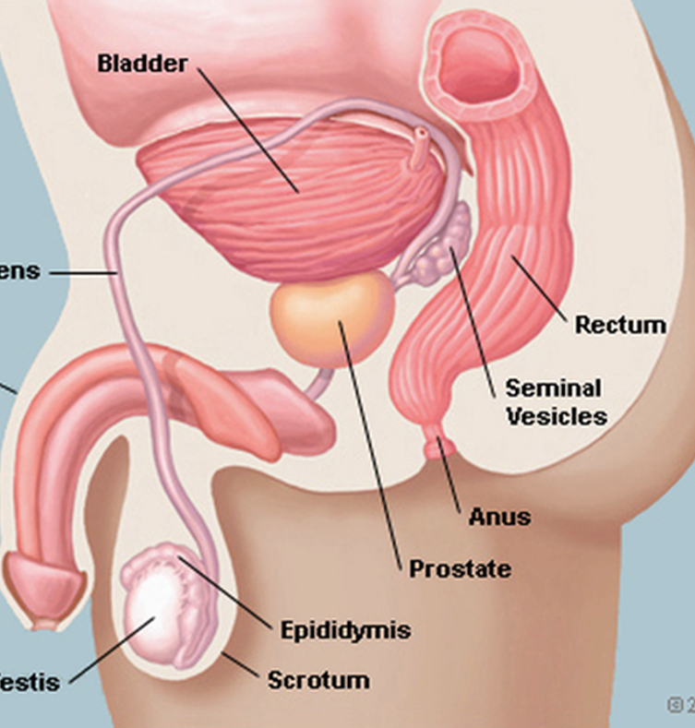
What Is The Prostate?
Small walnut shaped gland located in the male pelvis
Seminal Vesicles are attached to each side
It sits below the bladder and in front of the rectum
The prostate surrounds the urethra (tube that carries urine)
JOB – make fluid to bathe the semen

Slide 19
What Is BPH?
Benign Prostatic Hyperplasia
  Increase in prostatic stromal and epithelial cells in the Transition zone
  70% of US men 60-90 yrs, 80% ≥70 yrs affected¹
  Men tend to follow in their father’s footsteps whether BPH or Prostate Cancer
  The tissue causes urethral compression causing bladder outlet obstruction
    This causes Lower Urinary Tract Symptoms (LUTS)
    8% in men aged 30-39 years to 35% in men aged 60-69.² Similarly, the European and Korean UrEpik study reported that the prevalence of male LUTS increased 10% per decade from 40-79 years of age.³

Slide 20
What Is BPH?
  BPH is likely the result of a multifactorial process, the exact etiology is unknown
  It is clear that Testosterone and DHT play at a least a small role. The absence of these hormones prior to puberty prevents development of BPH
  BPH itself does not require treatment and is not the target of therapeutic treatment

Slide 21
What Are LUTS?
  Frequency
  Urgency with or without incontinence
  Hesitancy
  Intermittency
  Post void Dribbling
  Nocturia
  Slow/Weak Stream

Slide 22
How Are BPH And LUTS Related?
  BPH contributes to male LUTS via at least 2 routes
    Direct BOO from enlarged tissue
    From increased SM tone and resistance within the enlarged gland

Slide 23
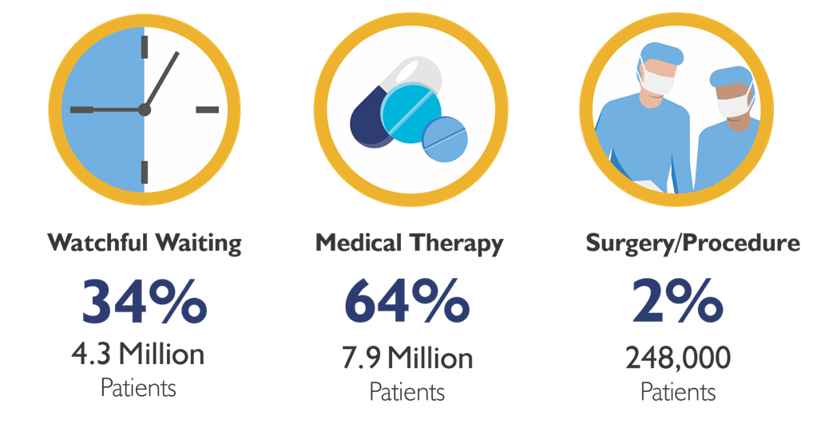
Current State Of BPH Population
16.3% or 2 Million men will discontinue drugs each year due to lack of efficacy.

Slide 24
BPH Treatments
  Herbal Medications
    Saw Palmetto
      No difference between placebo and Saw Palmetto⁴
  Beta-sitosterols
  Pumpkin Seed
  Stinging Nettle
    2012 Cochrane review showed no difference between treatment arms in terms of response and adverse affects for all the above herbals

Slide 25
BPH Treatments
Medications
  Alpha Blockers
    Increased risk of Cardiac failure (2021 study)
    Ejaculatory dysfunction
    Possible link to increased risk of dementia
  5 ARIs
    Decreased libido
    Erectile dysfunction
    Depression
    Increased risk of cardiac failure (2021 study)
  Combination therapy
  PDE5i
Only 33% are satisfied with the effectiveness of their medication.

Slide 26

Benefits And Side Effects Of BPH Medications: Comparison Of Outcomes At 1-2 Years
2. AUA BPH Guidelines 2003, 2010; 7. Jan Teper, Cent Eur J Urol 2011; 8. Traish, J Sex Med 2015; 9. Marihart al. Rev Urol 2005

Slide 27

Do BPH Drugs Address Bladder Outlet Obstruction (BOO)?
  The effect of BPH medications on BOO is minimal
  The increase in flow is significantly greater than placebo but is still modest*
  Bladder muscle (detrustor) overactivity is prevalent in patients with BOO
  Appears to persist after watchful waiting or treatment with medical therapy
* Tubaro, Drugs Aging 2003; 20 (3): 185-195; 2. De Nunzio, J Urol 2003 Feb. 169: 535-539

Slide 28
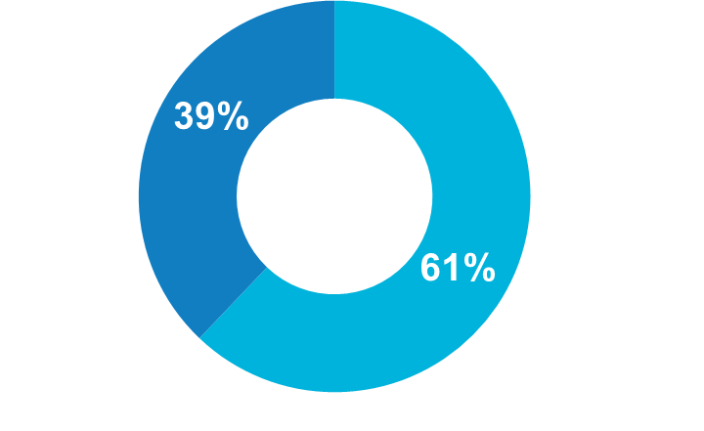
Untreated BOO: The Case For Early Intervention
UNTREATED BOO
May lead to irreversible bladder damage⁶
SURGERY PROVIDES
Maximum disobstruction
But irreversible bladder damage may have already occurred⁶
6 months after open prostatectomy,
only 61% of patients have
complete resolution of LUTS.⁵
6. Tubaro, Drugs Aging 2003; 20 (3): 185-195; 2. Flanigan, J Urol 1998 July; 160: 12-17; 3. Tubaro, J Urol 2001 July; 166: 172-176

Slide 29
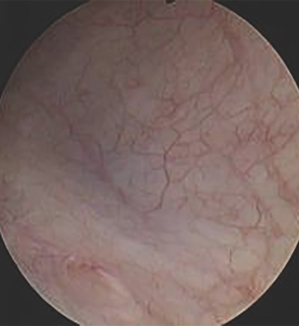
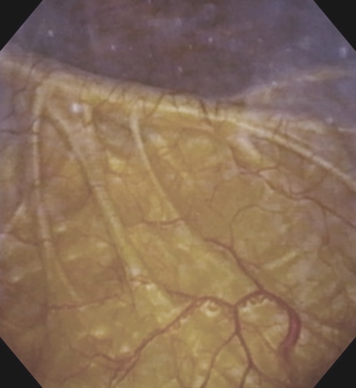
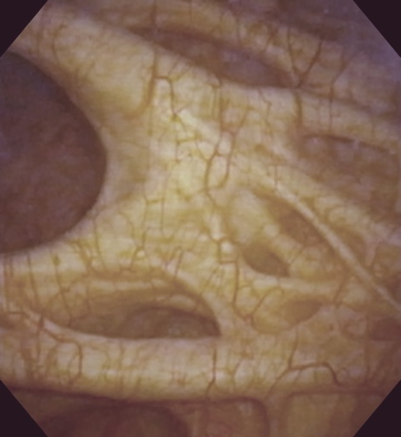
Disobstruction Has Been Shown To Preserve Bladder Health, Yet Only 2% Of Patients Elect Surgery/Procedure^{6,8,9}
  BPH meds provide symptom relief but do not adequately address
  bladder outlet obstruction (BOO)⁷
  Untreated BOO may lead to irreversible bladder damage⁷
Healthy Bladder
Bladder Worsens
Permanently Damaged
DISEASE PROGRESSION
We need to address obstruction earlier
in the disease.
The solution?
A procedure with faster recovery, fewer risks and proven outcomes.
6. NeoTract Market Model 2019-21 for Investors 1-11-19 based on IQVIA data;
7. Tubaro, Drugs Aging 2003; 20(3): 185-195; 8. Flanigan, J Urol 1998 July; 160: 12-17; 9. De Nunzio, J Urol 2003 Feb; 169: 535-539

Slide 30
Minimally Invasive Management
Urolift®
  Offered at Logan Health Urology
Rezum
  Not offered yet
  This involves steam

Slide 31
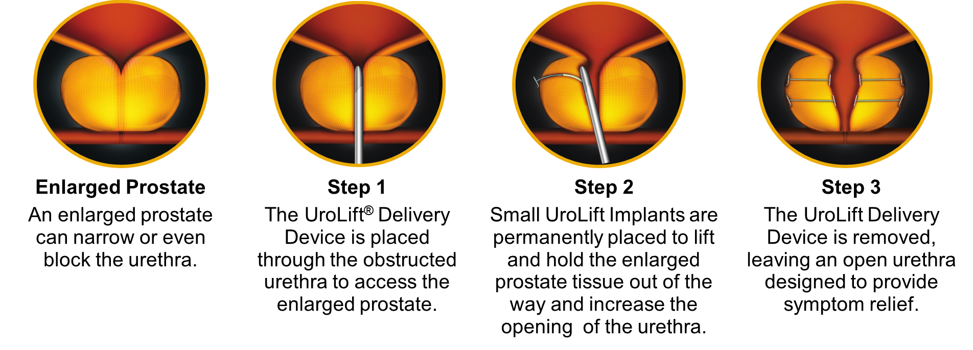
How The UROLIFT® System Works

Slide 32
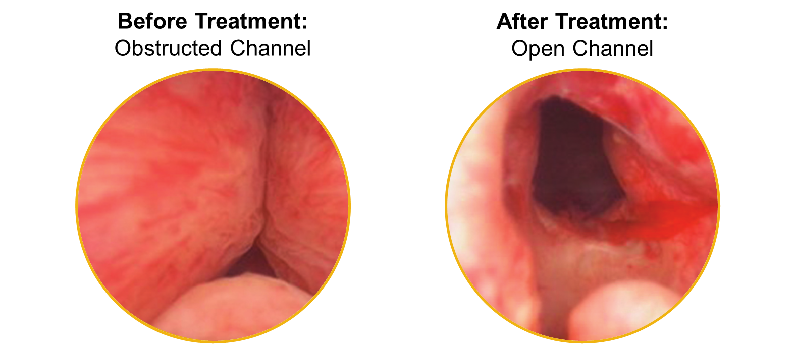
UROLIFT® System Treatment Images
Images representative of a typical effect
Individual results may vary

Slide 33
Surgical/Procedural Management
Transurethral Resection of the Prostate
PhotoVaporization of the Prostate
HoLEP
Robotic Simple Prostatectomy
All of these modalities cause Ejaculatory Dysfuction. Can cause possible Erectile Dysfunction and rarely cause incontinence

Slide 34
Surgical/Procedural Management
Aquablation
  Uses a heat-free waterjet controlled by robotic technology to remove prostate tissue.
Uses Ultrasound and cystoscope giving the surgeon the ability to see the entire prostate in real time.^{1,2}
Very low rate of irreversible complications – incontinence, ejaculatory dysfunction, erectile dysfunction^{1,2}

Slide 35
What Can You Do To Help Preserve Your Bladder Health?
Men over 40 should be evaluated
If you see that your symptoms are not improving or they are worsening on medications
If you cannot tolerate medications
If you don’t want your chronic catheter anymore

Slide 36
Urinary Incontinence
(UI)

Slide 37
What Is Incontinence?
It is defined as the complaint of involuntary loss of urine
Types of Urinary Incontinence
  Stress Urinary Incontinence (SUI)
  Urge Urinary Incontinence (UUI)
  Mixed Urinary Incontinence (MUI)
  And many more…
It is not NORMAL!

Slide 38
Facts
49.6% of women report UI
  49.8% pure SUI
  34.4.% MUI
  15.9% pure urgency UI
Among men, the prevalence increases with age
  11% of men 60-64 years of age
  31% > 85 years of age
Annual Costs projected
  2007 – $65.9 billion
  2015 - $76.2 billion
  2020 – $82.6 billion
  $3.8 Billion for men

Slide 39
Myths, Legends and Misinformation
“Leakage is a normal part of being a woman.”
“Leakage is a normal, inevitable part of aging – it only happens to older, not younger women.”
“It cannot be treated.”
“Surgery is the only way to treat it”
“My mother had bladder problems so I have it – it’s genetic.”
“All mesh is bad”
“The FDA recalled mesh slings used to treat SUI“

Slide 40
Risk Factors For Both Genders
Neurologic disease
Diabetes
Depression
Dementia
Chronic cough
Recurrent Cystitis
Pharmacologic therapies
Endocrine Disorders
Stool impaction
Reduced mobility

Slide 41
Risk Factors: Women
Increasing age
SUI
  Parity
  Higher BMI
  Vaginal Delivery
  Hormone Status
  Diabetes
  Family history
Urinary Fistula
UUI
  Age
  Outlet obstruction
  Pelvic Floor disorders
    Pelvic organ prolapse

Slide 42
Risk Factors: Men
Surgical Intervention
Radiation
Secondary to Bladder outlet obstruction
  Benign prostatic hyperplasia (BPH)
  Urethral Stricture disease

Slide 43
The most practical approach to the treatment of Urinary Incontinence involves trials of conservative management prior to embarking on surgical intervention.

Slide 44
Non-Surgical Treatment Of UI
Bladder retraining
Behavioral therapy
Dietary modifications
Lifestyle changes
Pelvic floor rehabilitation
Vaginal pessaries
Urethral inserts
Pharmacotherapy

Slide 45
How Will I Be Evaluated?
Voiding Diary
  Document fluid intake
  Quantification of urine output with voiding hat
  Uncontrolled loss of urine at day and night
  Degree of urge to go to the bathroom
Use and number of pads

Slide 46
How Will I Be Evaluated?
Physical Exam
  General examination
  Genitalia and pelvic floor examination
    Evaluate for prolapse (women)
    Cough test
  Rectal examination

Slide 47
How Will I Be Evaluated?
Urine Tests
  Urinalysis
Blood Work
  Blood sugar, HgbA1C
  PSA (men)
Post Void Residuals

Slide 48
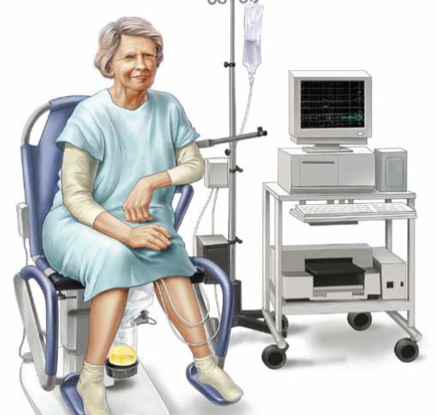
More Advanced Ways To Be Evaluated (Complex)
Urodynamic Studies
  Uncontrolled bladder contractions
  Urethral competence during filling
  Bladder function during voiding
  Residual urine after emptying

Slide 49
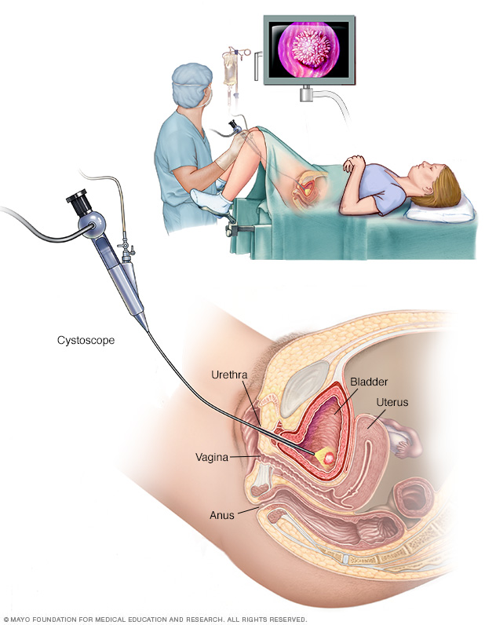
More Advanced Ways To Be Evaluated (Complex)
Imaging Studies
  Bladder Ultrasound- to evaluate for bladder mass, inflammation or stones
  X-ray studies with contrast (VCUG)
  MRI
Cystoscopy
  To evaluate anatomy
  Cough/leak test

Slide 50
Treatment
Pure Urgency UI
  Mostly MEDICAL
Pure Stress UI
Correct Anatomy
  Surgical vs Non-Surgical
Only treat if bothered

Slide 51
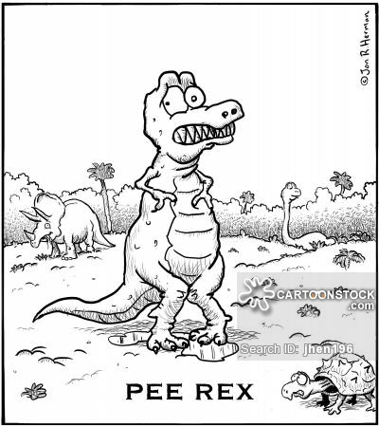
Stress Urinary Incontinence Surgical
Urethral bulking
Slings
  Midurethral
  Pubovaginal
Burch Colposuspension

Slide 52
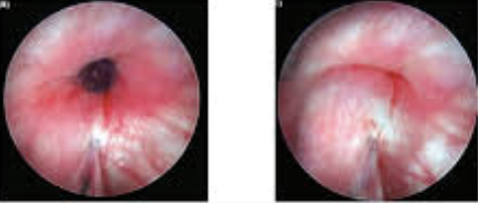
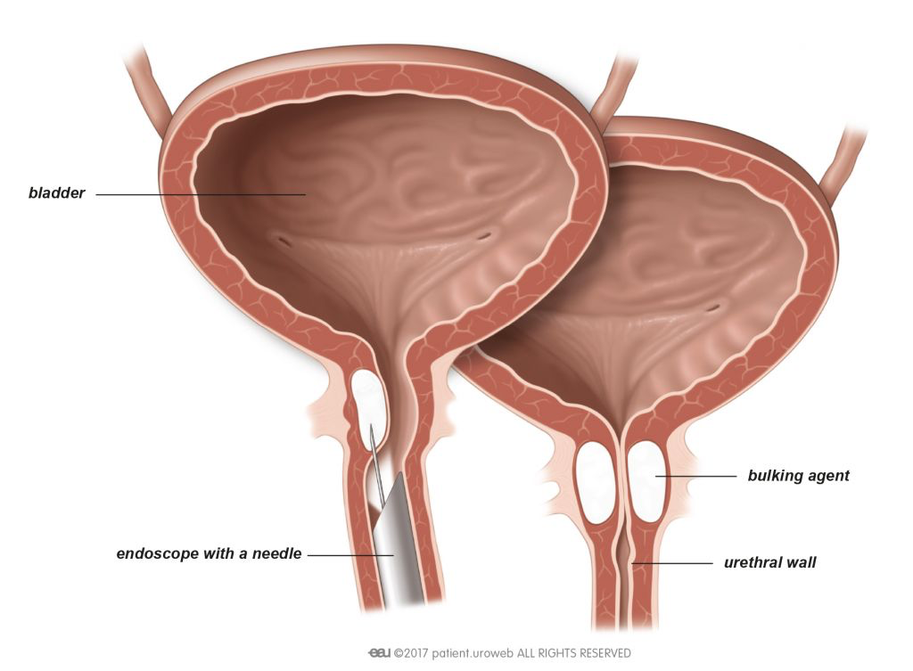
Urethral Bulking
Hypoallergenic, synthetic bulking material is injected transurethrally into the urethral submucosa for coaptation
  Increases urethral resistance

Slide 53
Urethral Bulking
Indications
  Low- to moderate-volume SUI
  Persistent SUI after other anti-incontinence procedures
  Poor surgical candidates (advanced age, high anesthesia risk, anticogulated etc)
    Can be done in- office or OR surgery center under light sedation
  Planning future pregnancies

Slide 54
Urethral Bulking
Pros
Least invasive “surgical option”
Maybe performed in Office
Cons
Temporary
  Patient’s usually need another injection within a couple of month, then yearly thereafter
  Less effective than a sling
  Urinary retention
  UTI
  Abscess
  Migration of bulking agent

Slide 55
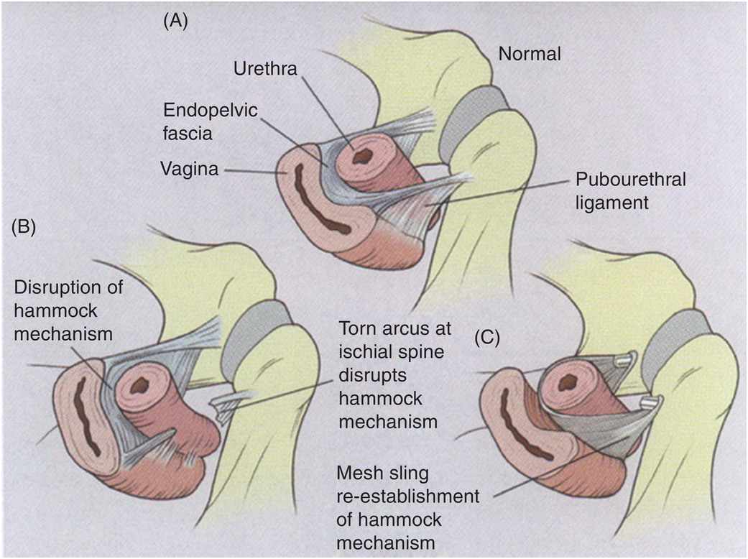
Suburethral Sling
Considered definitive treatment
Surgically corrects anatomy by repositioning the urethra and adding support
Reoperation rates are between 6-9% depending on sling placement
In women age <70yrs who have never
had previous incontinence surgery
  82% completely dry, no pads.
  9% markedly improved (1 light pad/day)
  9% no change.

Slide 56
Position Statements On Mesh
American Urological Association 2019
  Any restriction of the use of synthetic polypropylene mesh suburethral slings would be a disservice to women who choose to undergo surgical correction of SUI
  Mesh Mid urethral slings demonstrate good efficacy with acceptably low complication rates at 10-15 years of follow up.
AUGS/SUFU 2018
  Mesh MUS is the most extensively studied anti-incontinence procedure and remains standard of care for surgical treatment of SUI with superior safety and efficacy compared to their surgical procedures for SUI. #10 AUA update 2021 lesson 6
FDA supports use of MESH for SUI 2019.

Slide 57
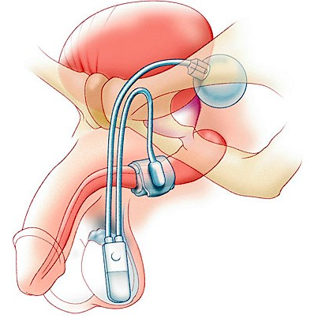
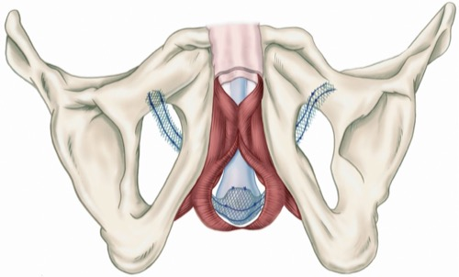
Male Stress Urinary Incontinence
Male Slings
Artificial Urinary Sphincter

Slide 58
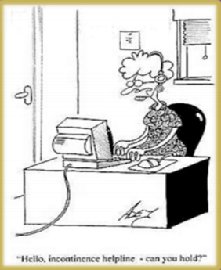
Part of the Overactive Bladder Symptom Complex
Urinary Urgency
Urinary Frequency
Nocturia
Urge Urinary Incontinence
Small Volume voiding
Pelvic discomfort

Slide 59
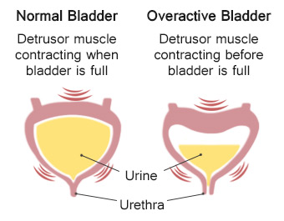

Slide 60

Dietary Changes
Adequate fluid intake
Avoid bladder irritants
    The 5 “Cs”
      Constipation
      Citrus
      Carbonation
      Chocolate
      Caffiene
    Spicy foods
    Alcohol

Slide 61
Dietary Changes
Avoid Constipation
  Increase Fiber
  Add Fruits and Veggies

Slide 62
Lifestyle Changes
Stop Smoking
  Reduces chronic cough to eliminate pressure on pelvic floor
Weight reduction
  Excessive body weight affects bladder pressures, blood flow and nerves
  Moderate weight loss was associated with a 47% reduction in urinary incontinence episodes in women with severe UI ( at least 10 episodes/week)
  Women who gained 11-22 lbs after age 18 have a 44% chance of weekly UI compared to women who stay within 4.4lbs of their baseline weight.
  Exercise is protective for SUI but not UUI.

Slide 63
Pelvic Floor Muscle Training
+/- Biofeedback
+/- Electrical or magnetic stimulation
Involves education on the anatomy and function on the pelvic floor muscles and strength training in order to control the lower urinary tract function
  40-50% chance that women can achieve satisfactory control of UI
  Help strengthen the muscles in the pelvis
  Active use of pelvic muscles to prevent urine loss
  Improve bladder stability
  Helps suppress urgency

Slide 64

Medication Therapy

Slide 65
Types Of Medications
Beta- 3 Adrenergic agonists
  Myrbetriq
    Side Effects
      Increased blood pressure
      Stuffy nose
      Headache
      UTI
Anticholinergic
  Muscarinic receptors
  Side Effects
    Constipation
    Dry mouth
    Dry eyes
    Memory loss and cognitive impairment

Slide 66
Other Therapies
Posterior Tibial Nerve Stimulation (PTNS)
Ecoin
Botox
Sacral Neuromodulation
InterStim
Axonics

Slide 67
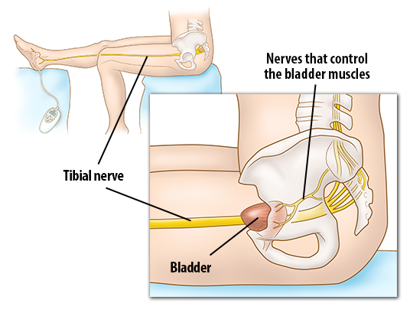
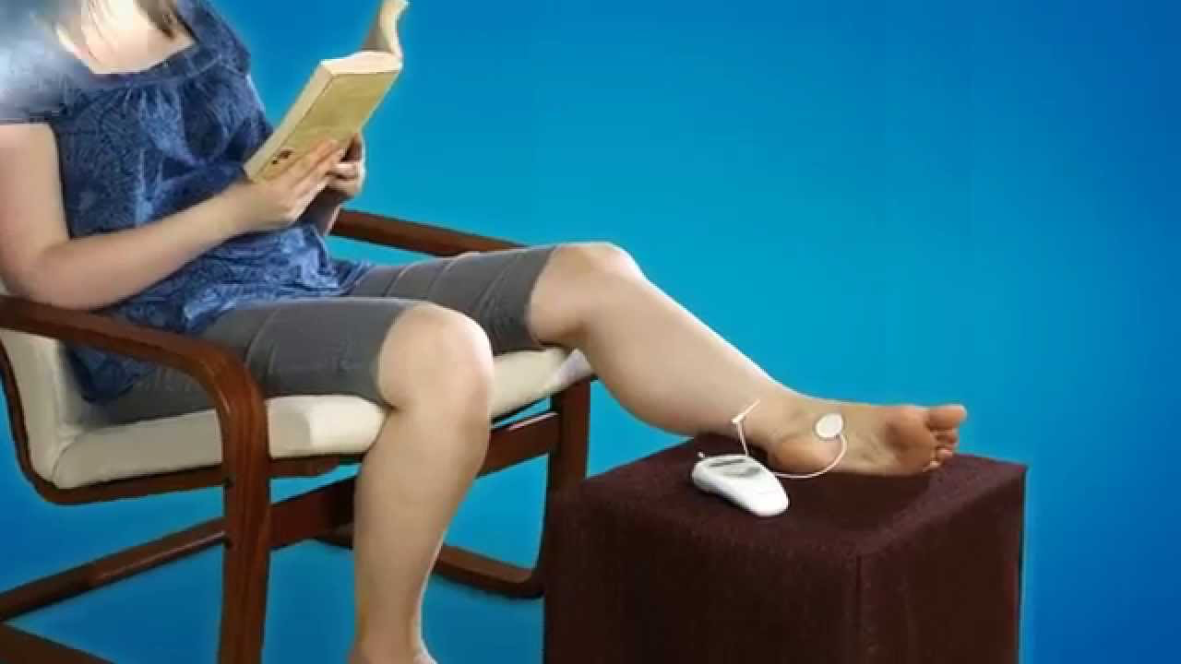
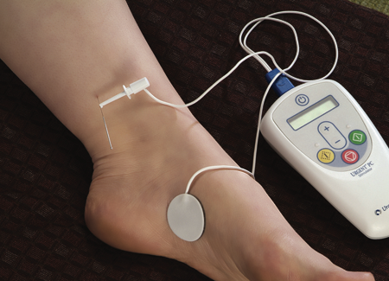
Posterior Tibial Nerve Stimulation
Electrical stimulation of the bladder via Tibial (ankle) nerve
  An alternative to medications
  Least invasive form of neuromodulation
  Indirect stimulation of the bladder using a nerve in the leg
  Recommend 12 treatments, 30 minutes each
Posterior Tibial Nerve Stimulation (PTNS)

Slide 68
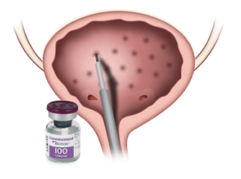
BOTOX
Botox
  Neurotoxin, Clostridium botulinum
  Injections into the bladder under direct vision
  Blocks the nerve ends with a chemical
  Starts working as soon as 2 days after injection

Slide 69
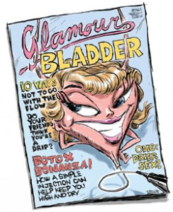
BOTOX
Botox
  Duration between 3-6 months
  Widely used for failure of medical therapy
  Not indicated for patients who do not empty well

Slide 70
BOTOX
Botox
  Side effects:
    Sometimes it works a little too well…retention
    Pain
    Bleeding
    Infections
Important Notes
    Wears off
    Re-injection needed
    Easy to do - 5-minute office procedure

Slide 71
Interventions
Sacral Neuromodulation (Interstim)
  “Pacemaker for the bladder”
  Another form of electrical stimulation
  Treatment indicated for:
    Urge incontinence
    Urinary retention
    Fecal incontinence
  Proven efficacy in patients for whom conventional therapy has failed
  FDA-approved x 14 years
  Good results in patient’s with neurologic conditions (MS, SCI)

Slide 72
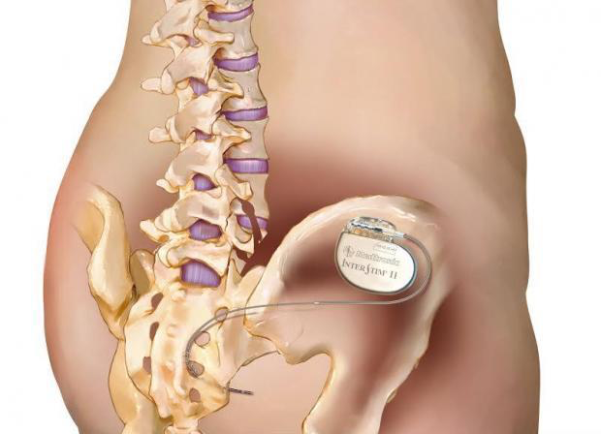
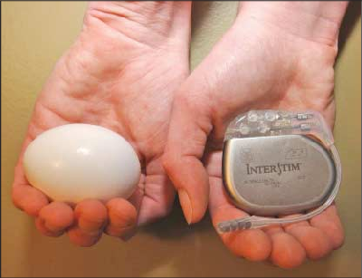
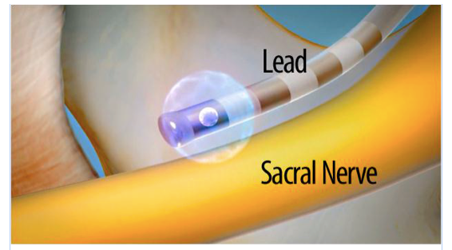
Interventions
Sacral Neuromodulation
  How does it work?
    Electrical lead placed next to bladder nerves
    Sends mild stimulation to the sacral nerves to modulate bladder activity
    Connected to a battery
      Battery changes every 3-5 years

Slide 73
Interventions
Surgery
  When all else fails…
  Bladder denervation
  Bladder augmentation
    Bladder becomes enlarged with an extension made from bowel
    Larger reservoir allows lower pressures

Slide 74
Erectile Dysfunction
(ED)

Slide 75
What Is Erectile Dysfunction?
ED is the persistent ability to attain and/or maintain a penile erection sufficient for satisfactory sexual performance.
52% of mean >40 yrs have some degree of ED
Testosterone decreases as we age

Slide 76
What Causes ED?
Vasculogenic
  Arterial Insufficiency
  Venous leak
Neurogenic
Psychogenic
  Depression
  Stress
  Anxiety
Endocrinologic
  Thyroid disorders
  Low Testosterone
Medications

Slide 77
Medications/Drugs That Cause ED
High blood pressure
  Betablockers, Thiazides, clonidine, methyldopa
Antidepressants and Antispychotics
Testosterone blockers
  Spironolactone
  Cimetidine
Sedatives
Alcohol
Tobacco smoking

Slide 78
Chronic Medical Conditions That Cause ED
Chronic Renal Failure
Diabetes
Chronic Liver Failure
Alcoholism
Thyroid disorders
High Blood Pressure
Arterial Plaques

Slide 79
Surgical And Traumatic Causes Of ED
Prostate removal
Bladder removal
Vascular surgery
Pelvic/Penile Fracture
Bicycle Riding
Pelvic Radiation
Spinal Cord injury

Slide 80

Erectile dysfunction is a risk factor for Cardiovascular disease

Slide 81
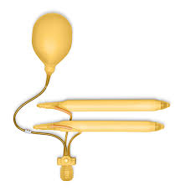
ED Treatments
Non-Medications
  Vacuum Erection Device
Medications
  Oral
  Penile injections
  Urethral Suppositories
Surgery
  Penile Prosthesis

Slide 82
Prostate Cancer

Slide 83
Prostate Cancer Stats
1 in 8 men will be diagnosed with prostate cancer in their lifetime
1 in 6 African American men will be diagnosed with prostate cancer in their lifetime.
1 in 41 men will die from prostate cancer
The 2nd most common cancer in men
98% 5 year survival according to SEER data.
3.1 million men living with prostate cancer in the US
Average age
66

Slide 84
Risk Factors For Prostate Cancer
Family History of Prostate cancer
African American Ancestry
Age >40
Genetic mutations
  BRCA 2, Lynch syndrome
Agent Orange Exposure

Slide 85
What Are The Symptoms Of Prostate Cancer?
Early stages
No symptoms
If the cancer grows but does not spread, symptoms are the same as prostate enlargement such as difficulty urinating and trouble with erections
Once the cancer has spread there can be symptoms from the cancer spread such as bone pain, swelling, and weakness

Slide 86
So…When Do We Screen?
This answer varies from the American Cancer Society, National Comprehensive Cancer Network, and the American Urological Association.
Let’s check them out!

Slide 87
American Cancer Society
Age 50
men who are at average risk of prostate cancer and are expected to live at least 10 more years.
Age 45
men at high risk of developing prostate cancer. This includes African Americans and men who have a first-degree relative (father or brother) diagnosed with prostate cancer at an early age (younger than age 65).
Age 40
men at even higher risk (those with more than one first-degree relative who had prostate cancer at an early age).

Slide 88
American Urological Association
Not screening men <40 years
Do not recommend routine screening in men 40 -50 years
  Exceptions
    African American Race
    Family history of prostate cancer
Greatest Benefit: Age 50 to 69 years.
Do not recommend routine screening in men age 70+ years
Do not recommend screening in men with less than 10-15 yr life expectancy

Slide 89
Why Have The Screening Guidelines Changed And Screening Declined?
Prostate, Lung, Colon, and Ovarian trial
  After 7-10 yrs of follow up, the rate of death from prostate cancer did not differ significantly between the two studies.
    Not a great study as it compared organized screening to opportunistic screening
European Randomized Trial of Prostate Cancer Screening
  After 16 yrs of follow-up:
    570 men would have to be screened to prevent 1 death
    18 men would have to be treated to prevent 1 death
Goteborg Trial- Sweden
  PSA every 2 years vs no screening in men 50-64 yrs with 18 yrs follow up
    35% reduction in relative risk of death
    231 men had to be screened to prevent 1 death.

Slide 90
US Preventative Service Task Force
In 2018, the USPSTF recommended having an informed discussion with your doctor if you are between the age of 55-69.
Prior to this the recommendations were no routine PSA screening.
  Panel made up of primary care clinicians without the input of those that treat prostate cancer.
Recommend against screening in men >70 yrs.

Slide 91
Can I Prevent Prostate Cancer
SELECT trial
  35, 533 randomized men > 50 with PSA <4
  Placebo, Vitamin E, Selinium, or Both
  After 8 years
    No intervention reduced the incidence of prostate cancer
    However, Vitamin E increased the risk

Slide 92
Can I Prevent Prostate Cancer
NBT trial
  Randomized 699 men with negative prostate biopsies, but a high risk of cancer
  Selenium or Placebo
  After 3 yrs
    No reduction in the incidence of prostate cancer.
HOPE Trial
  9641 randomized men >55
  Placebo or Vitamin E
  7 yr follow up: no reduction in the incidence of prostate cancer

Slide 93
Can I Prevent Prostate Cancer
Physicians Health Study
Vitamin E and C
8 yrs no reduction in incidence
Soy Vs Placebo
No reduction
Lycopene –no reduction
Green tea Catechins (600mg PO Q day)
Men with previous biopsies and HGPIN showed a reduction in the progression to prostate cancer from 53% to 11%.

Slide 94
Which Tests Are Used For Prostate Cancer Screening?
Prostate Specific Antigen (PSA)
Used clinically in 1987, FDA approved in 1994
Digital Rectal Exam ( DRE)
A DRE alone can miss 58% of cancers.

Slide 95
What Happens If My PSA Or DRE Is Abnormal?

Slide 96
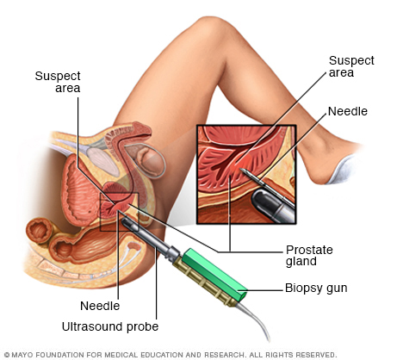
Prostate Biopsy
Trans rectal ultrasound guided biopsy
Needle samples of the most common sites for prostate cancer
Done in the office usually with local anesthesia
Can now use MRI to help target the biopsy

Slide 97
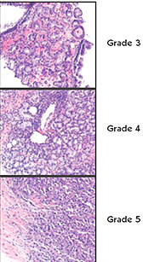
Biopsy Results
Less Aggressive
Benign prostate
Inflamed prostate
Cancer: this is given a Gleason grade for aggressiveness
More Aggressive

Slide 98
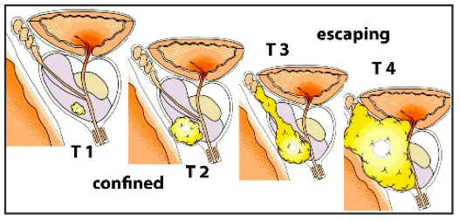
Prostate Cancer Stages

Slide 99
Treatment For Confined Prostate Cancer
Active surveillance
Surgery – open vs robotic prostatectomy
Radiation
Brachytherapy
External beam radiation
Other forms such as proton beam and cyberknife
Ablation treatments

Slide 100
Active Surveillance
For patients with low grade cancers and a small amount of cancer on their biopsy
Involves active monitoring of the cancer with scheduled tests to ensure that the cancer does not progress
Genetic testing of the prostate biopsy samples
PSA in 6mos
MR Fusion biopsy at one year

Slide 101
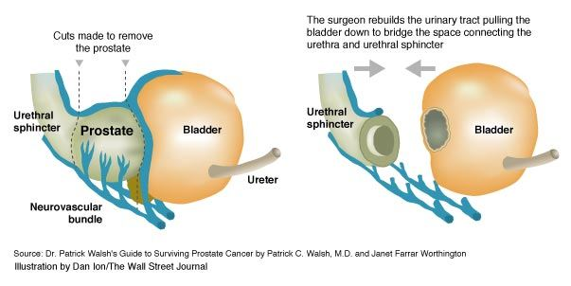
Prostatectomy
Complete removal of the prostate and the seminal vesicles

Slide 102
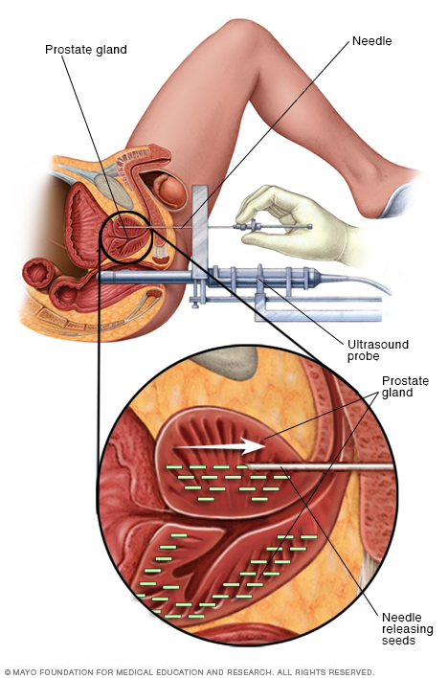
Brachytherapy
Radioactive seeds are implanted into the prostate and emit radiation in a targeted area

Slide 103
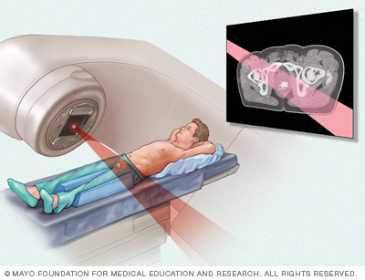
External Beam Radiation
Uses a special radiation machine to deliver high energy rays to the prostate

Slide 104

It’s Important To Have An Informed Discussion With Your Doctor About Screening

Slide 105
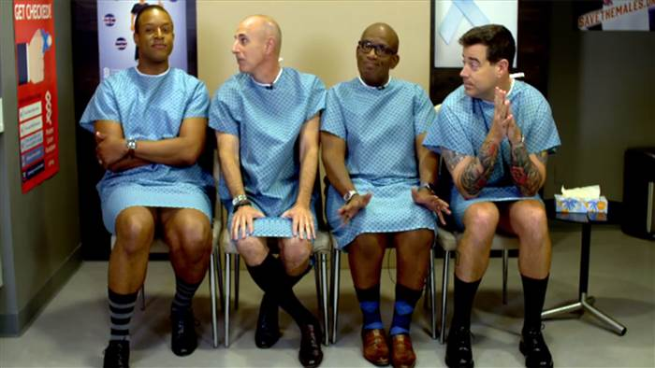
Questions?

Slide 106
References - RUTI
Omli R, Skotnes LH, Mykletun A et al: Residual urine as a risk factor for lower urinary tract infection: a 1-year followup study in nursing homes. J Am Geriatr Soc 2008; 56: 871.
Arnold JJ, Hehn LE and Klein DA: Common questions about recurrent urinary tract infections in women. Am Fam Physician 2016; 93: 560.

Slide 107
References - BPH
Wei, J. T., Calhoun, E., Jacobsen, S. J.: Urologic diseases in America project: benign prostatic hyperplasia. J Urol, 173: 1256, 2005
Kupelian, V., Wei, J. T., O'Leary, M. P. et al.: Prevalence of lower urinary tract symptoms and effect on quality of life in a racially and ethnically diverse random sample - The Boston Area Community Health (BACH) Survey. Archives of Internal Medicine, 166: 2381, 2006
Boyle, P., Robertson, C., Mazzetta, C. et al.: The prevalence of lower urinary tract symptoms in men and women in four centres. The UrEpik study. BJU Int, 92: 409, 2003
Barry, M. J., Meleth, S., Lee, J. Y. et al.: Effect of increasing doses of saw palmetto extract on lower urinary tract symptoms: a randomized trial. Jama, 306: 1344, 2011
. AUA BPH Guidelines 2003, 2010,2020
7. Jan Teper, Cent Eur J Urol 2011;
8. Traish, J Sex Med 2015;
9. Marihart al. Rev Urol 2005
Tubaro, Drugs Aging 2003; 20 (3): 185-195; 2. De Nunzio, J Urol 2003 Feb. 169: 535-539
NeoTract Market Model 2019-21 for Investors 1-11-19 based on IQVIA data;
Flanigan, J Urol 1998 July; 160: 12-17;
De Nunzio, J Urol 2003 Feb; 169: 535-539

Slide 108
References - Incontinence
Dooley Y, Kenton K, Cao G, et al. Urinary Incontinence Prevalence: Results from the National Health and Nutrition Examination Survey. Journal
Coyne, K. S., Wein, A., Nicholson, S. et al.: Economic burden of urgency urinary incontinence in the United States: a systematic review. J Manag Care Pharm, 20: 130, 2014
Anger, J. T., Saigal, C. S., Stothers, L. et al.: The prevalence of urinary incontinence among community dwelling men: results from the National Health and Nutrition Examination survey. J Urol, 176: 2103, 2006
Irwin, D. E., Milsom, I., Hunskaar, S. et al.: Population-based survey of urinary incontinence, overactive bladder, and other lower urinary tract symptoms in five countries: results of the EPIC study. Eur Urol, 50: 1306, 2006
Subak, L. L., Richter, H. E., Hunskaar, S.: Obesity and urinary incontinence: epidemiology and clinical research update. J Urol, 182: S2, 2009
Meyer, S., Schreyer, A., De Grandi, P. et al.: The effects of birth on urinary continence mechanisms and other pelvic-floor characteristics. Obstet Gynecol, 92: 613, 1998
Snooks, S. J., Barnes, P. R., Swash, M.: Damage to the innervation of the voluntary anal and periurethral sphincter musculature in incontinence: an electrophysiological study. J Neurol Neurosurg Psychiatry, 47: 1269, 1984
Cohn J. Urinary Incontinence: Etiology, patholophysiology. AUA University Core Curriculum. 2020 December 22.
Wu JM, Matthews CA, Conover MM et al: Lifetime risk of stress urinary incontinence or pelvic organ prolapse surgery. Obstet Gynecol 2014; 123: 1201.
Kobashi KC, Albo ME, Dmochoski RR Et al: Surgical treatment of female stress urinary incontinence: AUAU/SUFU Guideline. J Urol 2017; 198: 875
US Food and Drug Administration: Urogynecological Surgical Mesh Implants 2019. Available at https://www.fda.gov/medical-devices/implants-and prosthetics/urogy-necologic-surgical-mesh-implants.
Sung VW, Borello-France D, Newman DK et al: Effect of Behavioral and pelvic floor muscle therapy combined with surgery vs surgery along on incontinence symptoms among women with mixed urinary incontinence: the ESTEEM randomized clinical trial. JAMA 2019; 332: 1066

